Slide 1
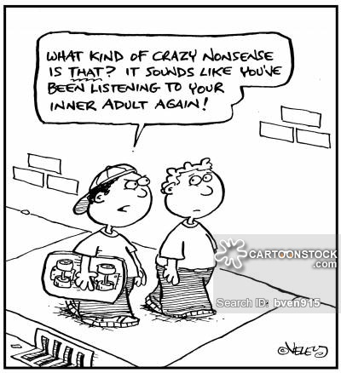
Developmental psychology
Geoff goodman, ph.d
Class 7

Slide 2
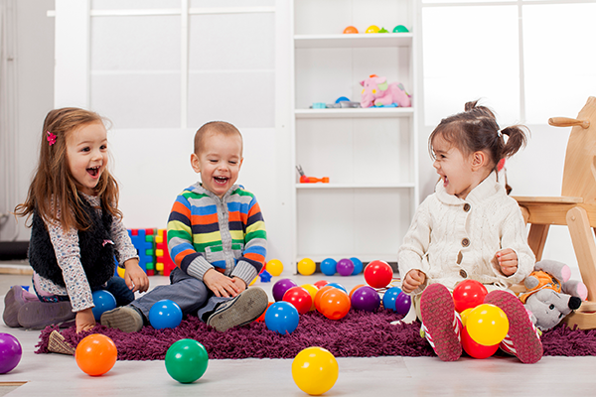
Early childhood: how things appear and how they are (3-6 years)
Sociodramatic play
A. Why do young children play?
1. piaget’s view
A. child’s attempt to make sense of recently accommodated experience
B. failure of adaptation to reality (retreat from accommodation into assimilation)
2. Vygotsky’s view
a. opportunity to develop imagination in action
B. necessary for adults as well as children in the development of cognition

Slide 3
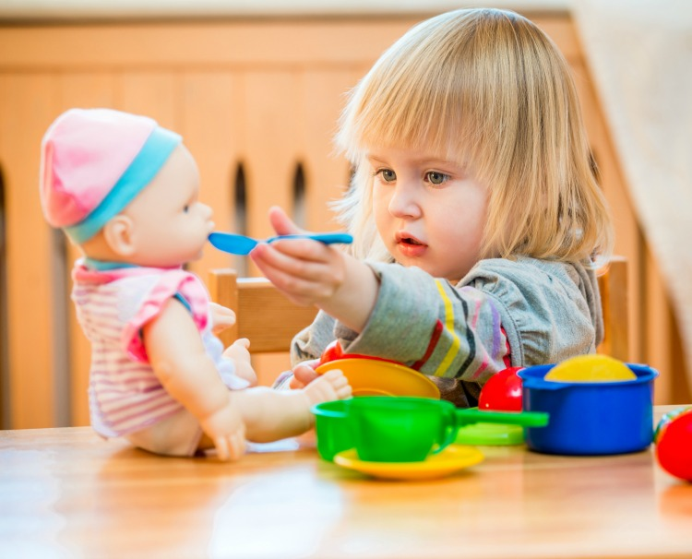
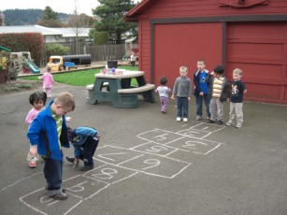
Sociodramatic play cont.
c. central line of development
1) attempt to make sense of past
2) anticipation of possible future
D. enhances perception by transforming it
E. fills gaps between desire to please parents and desire to be autonomous
F. child explores contradictions between social norms and personal motivations
G. child articulates and regulates emotions
H. child has control lacking in real life

Slide 4
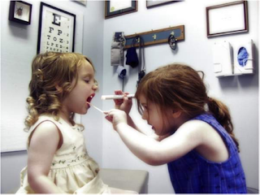
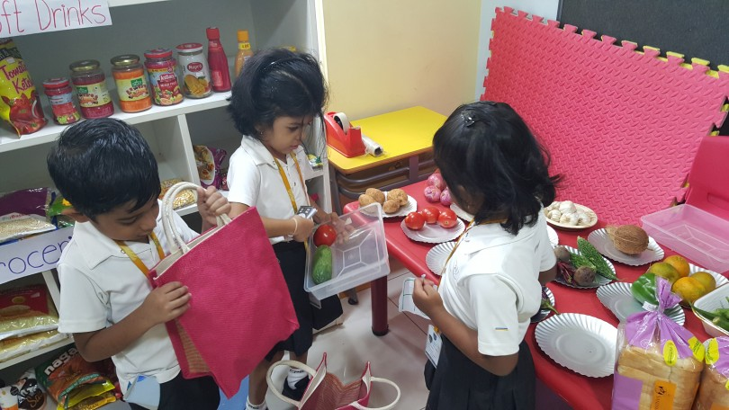
Sociodramatic play cont.
3. sociodramatic play – development of new competencies and skills
A. helps child master the distinction between appearance and reality
B. helps child increase self-control
C. helps child understand one’s own and others’ intentions and beliefs
D. helps child with language acquisition and construction of material symbols
E. helps child create and explore social situations and experiment with social conventions
F. helps child understand how his or her culture defines types of person
1) maleness and masculinity
2) femaleness and femininity
4. role of pretend play in development is inconclusive

Slide 5
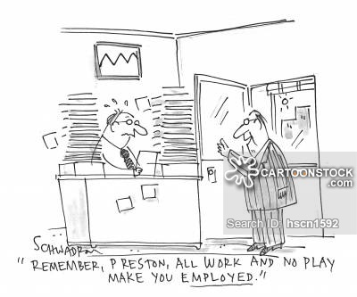
Sociodramatic play cont.
B. play across cultures
1. play is not as valued in other cultures as it is in the us
2. functions of play might be culture-specific
3. agrarian and hunter-gatherer societies
A. children assume work tasks early
B. the community depends on their labor
C. thus, play is less important as a way to learn

Slide 6
Sociodramatic play cont.
4. play materials in these societies
A. constructed by children themselves
B. sometimes used to play at adult activities (little fantasy play)
5. play might be tolerated rather than encouraged
C. the colonization of young children’s creativity
1. marketing to children’s fantasies to shape children to become consumers of media and commercial products
2. children also transform these raw materials into cultural artifacts

Slide 7
Sociodramatic play cont.
D. the preschool as a developmental niche
1. novel social institution with new demands
2. home routine is abandoned temporarily for new routine
3. relationships with peers begin – not family members
4. peer culture develops
5. preschool’s values
A. china – no spoiling → promoting independence and creativity
B. japan – socialization with peers → teaching traditional values
C. us – control of behaviors → school readiness and empirically supported teaching methods (i.e., no play)

Slide 8
Sociodramatic play cont.
6. long-term effects on children’s personality
7. preschool does not exist in some cultures (e.g., mayan)
E. peer culture in early childhood
1. “children are active producers of peer cultures which are handed down from one cohort of children to the next” (p. 295)
A. shared rituals and activities
B. collective insubordination to adult authority
C. enhances sense of having control over lives

Slide 9
Sociodramatic play cont.
2. children must learn appropriate “access strategies”
3. children can share tension, excitement, and relief of common fears
4. practice discourse strategies and refine communicative competence
5. social status learned
A. higher status
1) speak more frequently
2) use more imperatives toward lower-status characters

Slide 10
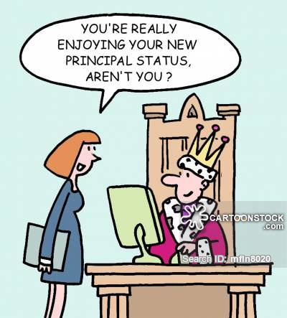
Sociodramatic play cont.
B. lower status
1) use more informative statements
2) display deference by obeying imperatives or asking for permission
C. status = power to direct others’ actions
D. understanding of social status does not extend to character of social institutions that define social roles
F. when young children work (kwara’ae)
1. kwara’ae have no word for “fantasy”
2. little time for imaginative play

Slide 11
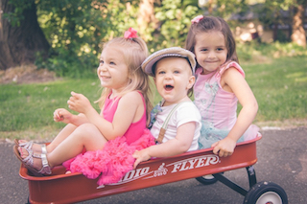
Sociodramatic play cont.
3. two modes of “pretend”
A. child mode – running around, giggly, moody, imitating adults
B. adult mode – calm, rational, speaking and carrying their bodies as adults do when working
4. adult mode is “a form of sociodramatic play that accomplishes real work” (Watson-gegeo, p. 299)
5. kwara’ae children engage in child-mode sociodramatic play apart from adults (playing at doing real work)

Slide 12
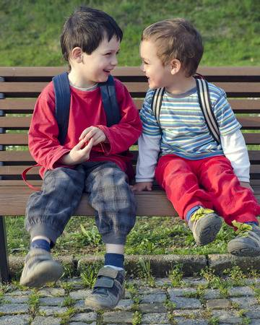
Talking as both doing and understanding
A. combining two macrofunctions
1. pragmatic – talking as action (doing)
2. mathetic – talking as learning (understanding)
3. into metafunctions
A. ideational – observer function (speaker’s interpretation of the world)
B. interpersonal – intruder function (speaker’s involvement in the speech situation)

Slide 13
Talking as both doing and understanding
4. three new strategies now available to expand the semiotic system
A. children can refine meanings built up in system by introducing more delicate distinctions
1) “it may be” (rather than “it is” or “it isn’t”)
2) “run” (rather than “go”)
B. children can extend meaning into new areas of experience not previously available
1) “What”
2) “if”
3) “Because”

Slide 14
Talking as both doing and understanding
c. combination of first two strategies (deconstructing and recombining)
1) “iced coffee” (rather than “hot coffee” and “iced tea”)
2) “chili dog” (rather than “chili con carne” and “hot dog”)

Slide 15
The world of early childhood: breaking from the visual
A. the young child’s thinking about the world
1. realism – belief that thoughts and dreams are material; names are parts of objects
2. animism – belief that all things possess life and consciousness – provides unity with the world and produces magical beliefs
3. artificialism - human beings created all natural phenomena
4. syncretism – thinking based entirely on what can be seen and experienced firsthand

Slide 16
The world of early childhood: breaking from the visual
5. children lack an understanding of dualisms
A. mental vs. material
B. internal vs. external
C. biological vs. nonbiological
D. objects vs. representations
6. preoperational thinking
A. lacking the ability to explain causal relationships
B. lacking the ability to distinguish appearance from reality
c. Lacking understanding that an object has a hidden identity (enduring in spite of transformations)

Slide 17
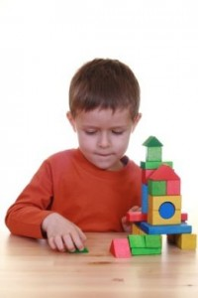
The world of early childhood: breaking from the visual
B. captured by appearances
1. preoperational intelligence
A. confused, slow, and concrete (tied to practical action)
B. egocentric – lacking ability to understand the existence of others’ points of view
1) no need to justify thinking
2) lacking ability to think about one’s own thoughts

Slide 18
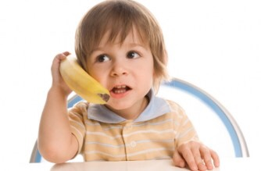
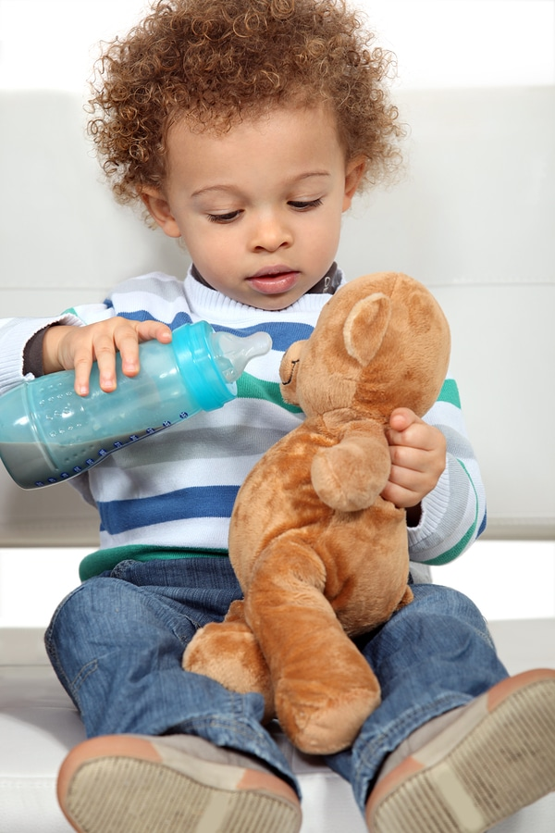
The world of early childhood: breaking from the visual
C. unsophisticated mental representations
1) representations of states of physical things
2) not transitions between states
3) static thinking
4) centration – focusing on one aspect while ignoring others
5) reversibility – cannot reason about consequences of reversing a transition

Slide 19
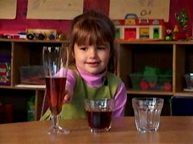
The world of early childhood: breaking from the visual
D. contrast with adult thinking
1) identity constancy – remains same play-doh
2) decentration – both width and length change
3) reversibility – transformation can be reversed
4) distinction between appearance and reality (understanding that appearances might be deceptive)
2. the allure of the visual
A. young children can reason correctly about a conservation task when liquids are hiddeN

Slide 20
The world of early childhood: breaking from the visual
1) seeing movement misleads young child
2) cannot represent the transition
3) appearance interferes with their thinking
B. how do children break away from the visual interference as they age?
1) language development
2) internalized verbal formula that protects against overwhelming appearance of visual displays
3) talking about a situation influences thinking

Slide 21
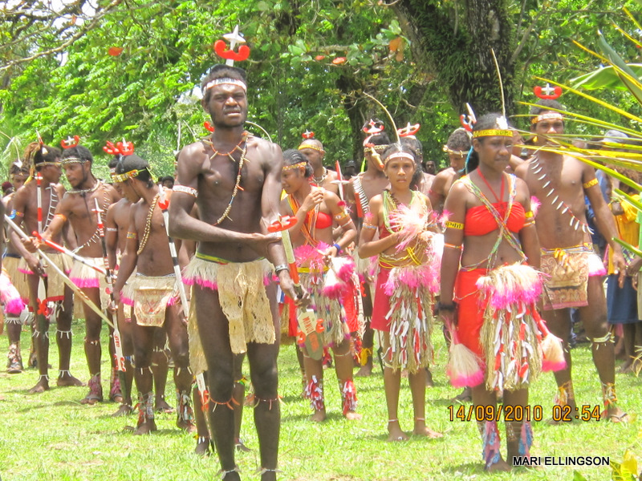
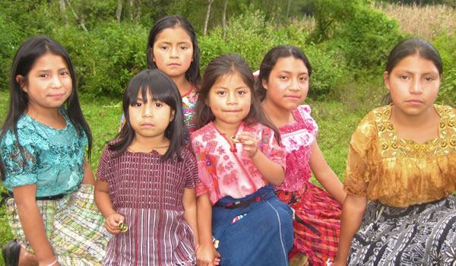
The world of early childhood: breaking from the visual
C. thinking about the natural world
1. manus people – adults attribute spirit powers to the
operation of wind chimes, while their children attribute the
wind to the operation of wind chimes
A. children did not participate in adult rituals
B. children did not understand spirit relations
C. piaget’s claims about animism need to be examined in a cultural context
2. the yukatek maya people – adults reason in a systematic way
A. two biological entities classified together based on their relations to the ecology in which they live
B not based on similar characteristics

Slide 22
The world of early childhood: breaking from the visual
3. us children
a. anthropocentric bias – thinking about animals based on what they know about humans (lion king)
B. us children not as familiar with animals and plants as yukatek mayan children
4. knowledge and thinking about biology depend on the particular experiences a young child has gained from living in specific circumstances

Slide 23
The world of early childhood: breaking from the visual
D. culture and cosmology
1. ontological turn – different cultures inhabit different worlds (cosmology)
2. cosmovision – different ways of perceiving the same reality
3. two examples
A. culture vs. nature
b. Humans vs. animals

