Slide 1
The Effect of Parenting Style on the Development of Antisocial Behaviors in Adolescents

Slide 2
Antisocial behavior
Antisocial behavior can be described as:
Aggression to people and animals
Destruction of property
Deceitfulness or theft
Serious violations of rules
Lack of remorse, guilt or empathy

Slide 3
Parenting styles history
Schaefer (1959) first introduced a model to describe the pattern of parenting style based on three dichotomies: acceptance versus rejection, psychological autonomy versus psychological control, and firm behavior control versus lenient behavioral control.
Baumrind (1967) later theorized, authoritative, authoritarian, and permissive, as the three main styles of parenting.
Maccoby and Martin (1983) have further conceptualized the parenting styles through the dimensions of demandingness and responsiveness. Demandingness refers to parental control or parental power assertion while responsiveness refers to parental acceptance, warmth, support, and attunement to the child’s needs (Maccoby & Martin, 1983). Using these dimensions, Maccoby and Martin (1983) have added uninvolved parenting as the fourth parenting style.

Slide 4
AUTHORITATIVE
Believed to be the best parenting style
Parent exerts firm control over child, while also being accepting, warm, and allowing for psychological autonomy of the child
Supportive of the child’s independence
Frequently express love and affection
Related to positive child outcomes such as social responsibility, adjustment, and self reliance

Slide 5
permissive
Parents are conceptualized as indulgent and allow their children to make their own rules and decisions
Parents are accepting of the child and allow for psychological autonomy but lack in parental control
Parents are affirming and place few demands on the child
Related to child outcomes such as lack of impulse control, and lower achievement and autonomy

Slide 6
uninvolved
Parents behave in ways that minimize parenting efforts and time
Rejecting and do not enforce behavioral control on the child
Neglecting and may respond with hostility towards the child

Slide 7
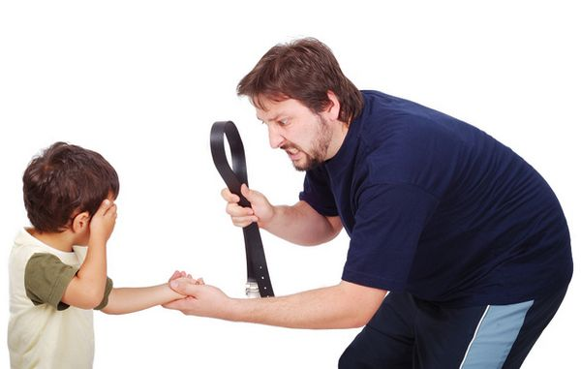
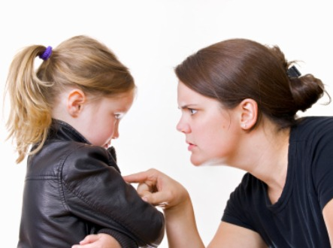
AUTHORITARIAN
Parent exerts firm physical and psychological control
Parents are rejecting of the child
Demanding and often coercive and domineering
Highly controlling and do not encourage independence
Value obedience and will turn to forceful measures as punishment if they consider the child’s behavior to be inappropriate
Related to maladaptive behaviors in the child, rebellion, low self-efficacy and more externalizing problems
Physical punishment from parents has been linked to increased aggressive behavior in their children as well as high rates of maladaptive behaviors and criminal behavior

Slide 8
hypothesis
The present study is designed to investigate the effect of parenting style on the presence of antisocial behaviors in adolescent males. It is hypothesized that adolescents who have been raised under an authoritarian parenting style will report higher instances of antisocial behaviors than adolescents who have been raised under any other type of parenting style (authoritative or permissive).
Uninvolved parenting will not be defined as a separate parenting style given the measures used in this study

Slide 9
participants
500 male high school students from the New York Metropolitan area with an age range of 13-17 years (N = 500, M = 16.8 years, SD = 0.53 years)

Slide 10
Measures
Socio-demographic Questionnaire
Parental Authority Questionnaire (PAQ) – Buri, 1991
30-item self report measure completed by the adolescent to assess parenting style based on Baumrind’s parental authority classification: authoritative, authoritarian, and permissive
Comprised of 5-point Likert scale based on applicability of each statement to the child’s mother or father:1= strongly disagree, 2 = disagree, 3 = neither agree nor disagree, 4 = agree, 5 = strongly agree
The PAQ has three subscales: permissive (10 items), authoritarian (10 items), and authoritative (10 items). A higher score on a subscale indicates that the parent being rated engages in more aspects of that style in their parenting
Scores on each subscale range from 10 to 50
Self-Report of Antisocial Behavior – Kiesner, 2002
18-item self-report measure that assesses the individual’s antisocial behaviors
Participants are asked to indicate how often they were involved in a behavior in the past month using a 4-point Likert scale: with 0 = never, 1 = rarely, 2 = sometimes, 3 = frequently
Some assessment items included “lied to parents”, “hit someone”, “stole something from a store”, “did graffiti on public transportation or property”, “used alcohol”, and “used drugs”
Higher scores indicate higher amounts of antisocial behaviors with scores ranging from 0 to 54

Slide 11
data analysis
An independent-samples t-test was conducted using the Statistical Package for the Social Sciences (SPSS) program to compare the amount of antisocial behaviors in children raised under authoritarian parenting styles, and children raised in the other parenting styles (authoritative or permissive).

Slide 12
significant
There was a significant difference in the amount of antisocial behaviors for the authoritarian parenting style (M = 21.2, SD = 1.3), and the other parenting style conditions (M = 7.5, SD = 0.84); t = 2.89, p < .05.
These results support the hypothesis and suggest that parenting style does have an effect on the amount of antisocial behaviors an adolescent engages in. Specifically, when an adolescent is raised under an authoritarian parenting style, they will take part in significantly more antisocial behaviors than children raised under other parenting styles.

Slide 13
nonsignificant
There was not a significant difference in the amount of antisocial behaviors for the authoritarian parenting style (M = 10.2, SD = 1.3), and the other parenting style conditions (M = 9.5, SD = 1.2); t = 1.02, p > .05.
These results suggest that parenting style does not have an effect on the amount of antisocial behaviors that an adolescent engages in. The hypothesis is not supported, and there is no significant difference between authoritarian parenting style and the other parenting styles when measuring for antisocial behaviors in adolescents.
Given these results, other factors besides parenting style may be involved in the development of antisocial behaviors. Factors such as attachment, empathy, socioeconomic status, social groups, specifics of abuse or neglect, and access to resources may predict antisocial behavior more accurately.
A study conducted by Wootton et al. (1997) suggests that parental influence on antisocial behavior depends on the level of empathic traits in the child and that the child’s externalizing problems were unrelated to ineffective parenting for children who were unemotional and callous.

Slide 14
Discussion Significant
Authoritarian parenting styles may be associated with antisocial behaviors due the harsh nature of authoritarian parenting. These parents expect orders to be obeyed by the child without an explanation and combine high control with strict discipline and aggressive behaviors
Authoritative and permissive parents may vary in demandingness, but both groups exhibit warmth and are accepting of the child, which is not found in authoritarian parenting, and may explain why there were fewer instances of antisocial behaviors reported in the authoritative and permissive groups.
The physical punishment involved in an authoritarian parenting style provides a model of aggressive behavior for the child, and it has been found that most child abusers had previously been abused themselves (Olafsson, 2000). McCord (1988) posited that abused children learn that the aggression is “normal and justified”, and “egocentrism” becomes highly regarded since the use of violent behaviors to influence others is deemed acceptable.

Slide 15
Discussion nonsignificant
Given these results, other factors besides parenting style may be involved in the development of antisocial behaviors. Factors such as attachment, empathy, socioeconomic status, social groups, specifics of abuse or neglect, and access to resources may predict antisocial behavior more accurately.
A study conducted by Wootton et al. (1997) suggests that parental influence on antisocial behavior depends on the level of empathic traits in the child and that the child’s externalizing problems were unrelated to ineffective parenting for children who were unemotional and callous.

Slide 16
references
American Psychiatric Association. (2013). Diagnostic and statistical manual of mental disorders (5th ed.). Washington, DC: Author.
Baumrind, D. (1966). Effects of authoritative parental control on child behavior. Child Development, 37, 887-907. doi:10.2307/1126611
Baumrind, D. (2013). Authoritative parenting revisited: History and current status. In R. E. Larzelere, A. S. Morris, & A. W. Harrist (Eds.) Authoritative parenting: Synthesizing nurturance and discipline for optimal child development (pp. 11-34). Washington, DC: American Psychological Association Press. doi:10.1037/13948- 002
Boyes, M., & Allen, S. (1993). Styles of parent-child interaction and moral reasoning in adolescence. Merrill Palmer Quarterly, 39(4), 551-570.
Buri, J. R. (1991). Parental Authority Questionnaire. Journal of Personality Assessment, 57(1), 110-119. doi:10.1207/s15327752jpa5701_13
Darling, N., & Steinberg, L. (1993). Parenting style as context: An integrative model. Psychological Bulletin, 113(3), 487-496. doi:10.1037/0033-2909.113.3.487
Grogan-Kaylor, A. (2005). Corporal punishment and the growth trajectory of children’s anti-social behavior. Child Maltreatment, 10, 283-292.
Kiesner, J., & Pastore, M. (2005). Differences in the relations between antisocial behavior and peer acceptance across contexts and across adolescence. Child Development, 76(6), 1278- 1293. doi:10.1111/j.1467-8624.2005.00850.x

Slide 17
References cont.
Maccoby, E. E., & Martin, J. A. (1983). Socialization in the context of the family: Parent-child interaction. Handbook of Child Psychology: Vol 4. Socialization, personality, and social development (4th ed., pp. 1-101). New York: Wiley.
Marcus, R. F., & Gray, L. (1998). Close relationships of violent and nonviolent African American delinquents. Violence and Victims, 13, 31-46.
McCord, J. (1988). Parental behavior in the cycle of aggression. Psychiatry: Interpersonal and Biological Processes, 51(1), 14-23.
Miller, P., & Eisenberg, N. (1988). The relation of empathy to aggressive and externalizing/antisocial behavior. Psychological Bulletin, 103(3), 324-344.
Morris, A. S., Cui, L., & Steinberg, L. (2013). Parenting research and themes: What we have learned and where to go next. In R. E. Larzelere, A. S. Morris, & A. W. Harrist (Eds.), Authoritative parenting: Synthesizing nurturance and discipline for optimal child development (pp. 35-58). Washington, DC: American Psychological Association Press.
Music, G. (2011). Nurturing natures: Attachment and children’s emotional, sociocultural and brain development. New York: Psychology Press.
Olafsson, K. (2000). The impact of parenting style and locus of control upon psychopathy, degree of violence, and attitude towards authority in youthful offenders (Unpublished doctoral dissertation). The California School of Professional Psychology, Alameda.
Schaefer, E. S. (1959). A circumplex model for maternal behavior. Journal of Abnormal and Social Psychology, 59, 226-235. doi:10.1037/h0041114
Schaffer, M., Clark, S., & Jeglic, E. L. (2009). The role of empathy and parenting style in the development of antisocial behaviors. Crime and Delinquency, 55(4), 586-599. doi:10.1177/0011128708321359
Wootton, J. M., Frick, P. J., Shelton, K. K., et al. (1997) Ineffective parenting and childhood conduct problems: The moderating role of callous-unemotional traits. Journal of Consulting and Clinical Psychology, 65, 292-300.

