Slide 1
Developmental psychology
Dr. Geoff goodman
Lecture 7
10/25/16

Slide 2
Play, fun, symbolizing, practicing, and mucking about
Introduction
Characteristics of play
Intrinsic value – engaging in rewarded tasks kills fun
Separate from but related to reality
Related to capacity to symbolize and to create
Flexibility of roles, combinations, and representations
Positive affect is typically associated with play
Play conditions
Less stress
More confident
Less anxious
Nurturing family context
Security facilitates play, and play facilitates security

Slide 3
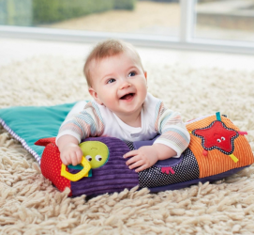
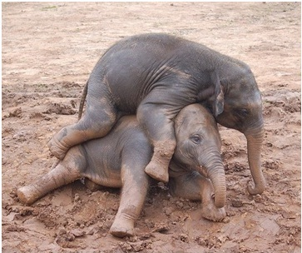
Play in infancy
Training for the unexpected begins in infancy (near end of first year)
Increased mobility, dexterity, and speed
Precursors of role play, fantasy, and imaginary games
Play becomes richer and fuller under secure conditions
Play in other species
Play is considered as a discrete neurological system along with fear, sex, aggression, and attachment (panksepp, 2007)
Play has been observed across all cultures and in many mammalian species
Play has been selected for evolutionary reasons
Key to development of exploratory-assertive motivational system
Key to solidifying social habits
Key to developing physical and cognitive capacities
Rats reared in isolation without opportunities to play-fight become victimized in adulthood

Slide 4
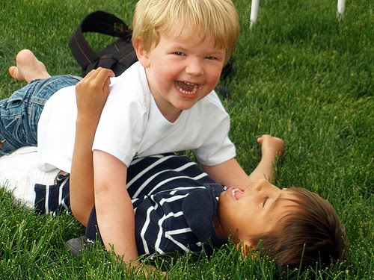
Rough and tumble
Characteristics of rough-and-tumble play (Pellegrini, 2007)
Positive affect
Play face
High energy
Exaggerated movements
Soft, open-handed hits or kicks
Rough-and-tumble play diminishes with sexual maturation
Purposes of rough-and-tumble play
Aids muscular skills
Builds strength
Stimulates brain development
Increases affiliative bonds
In adolescence, rough-and-tumble play is used to establish dominance and status in the social hierarchy
Boys tend to engage in more rough-and-tumble play than girls due to having been exposed to more androgens in utero

Slide 5
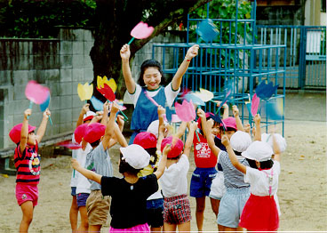
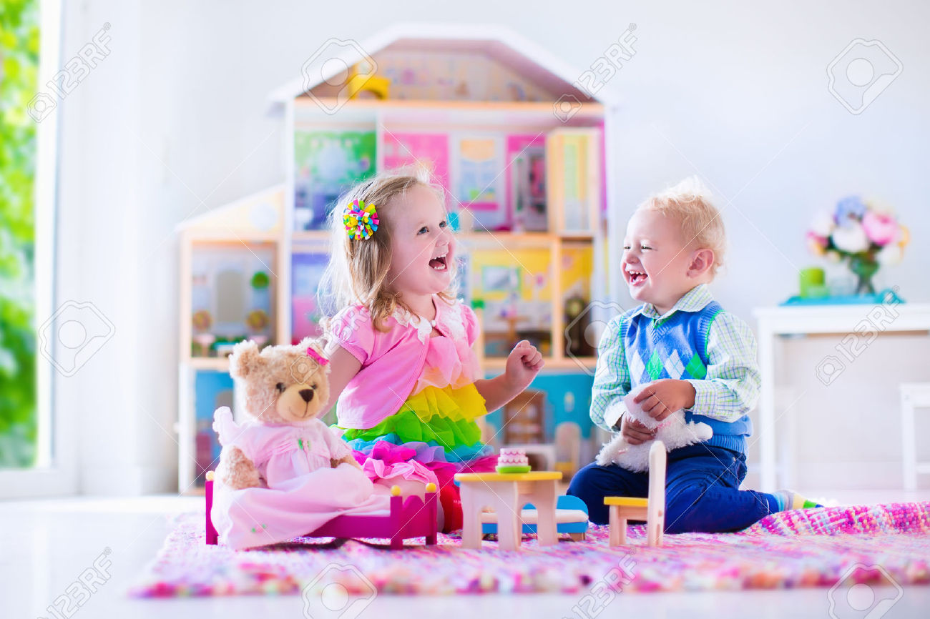
Different kinds of play, different kinds of learning
Play differs by culture but contains commonalities
Most children act out scripts of everyday adult life
Mayan boys pretend to be bar owners
Ugandan children pretend to be farmers
Beliefs about the role of symbolic play differ by culture
American parents – symbolic Play aids in learning
Korean parents – play is amusement
Japanese parents – sociocentric play is encouraged
Taiwanese parents – play should symbolize proper conduct
Turkish, yucatan maya parents – symbolic play not valued
Is play perceived as skill practice or an activity that facilitates more abstract thinking?

Slide 6
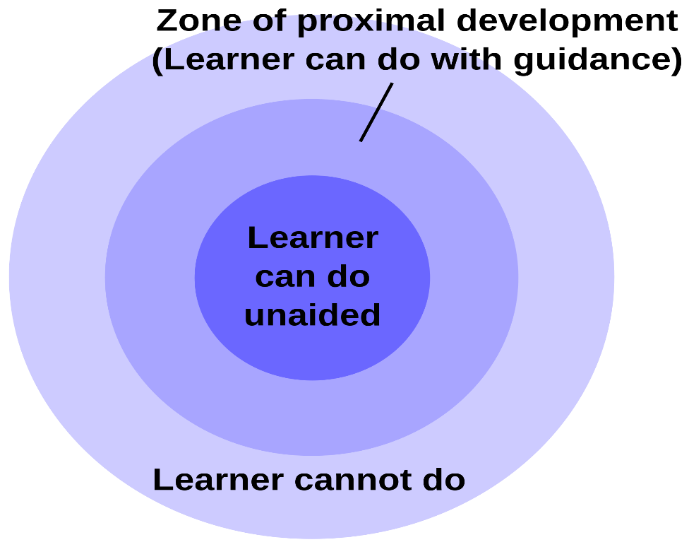
Different kinds of play, different kinds of learning cont.
Children learn best in a playful environment that balances structure and free play
Tools of the mind (barnett et al., 2008)
Storytelling/story-acting (stsa; paley, 1990)
Zone of proximal development – build on current knowledge and skills to reach next level
Children engaged in this kind of play build capacities
Longer periods of concentration
Increased ability to plan, concentrate, and self-regulate
Increased ability to engage in complex interactions
Other educational and emotional advantages

Slide 7
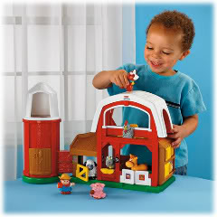
Play as a window into the psyche
Play has been harnessed for diagnostic purposes
Children’s preoccupations are expressed symbolically
Standard assessments of play
Children’s developmental play instrument (chazan)
Attachment story-completion task (bretherton)
Play has been harnessed for therapeutic purposes
Children’s play can be worked on in the same manner as free associations and dreams in adult therapy
Play can be used in child therapy from a wide range of theoretical orientations
Play always has some connection, however obscure, to past experiences
Traumatic play
Not therapeutic
Like flashbacks in adults
Repetitive, stereotyped, and rigid
Projection of unwanted feelings into participants and objects
Disrupted communication of unconscious feelings (i.e., wishes and anxieties) – hurricane hugo

Slide 8
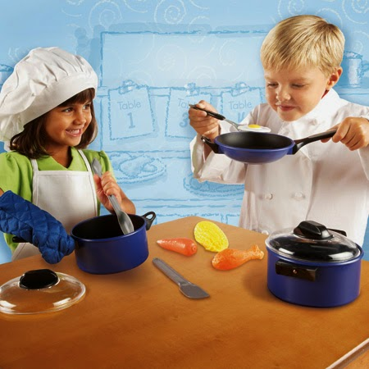
Play, pretending, symbolism, and growing minds
Play allows child to “try on” different ways of being
Doctor - patient
Teacher - student
Mary - baby jesus (carlyn)
Play allows child to learn how an adult thinks, acts, feels, and understands the world “from the inside”
Children are tipped off to pretense when
There is more smiling and longer smiling
Smiling means more than just an expression of pleasure
Longer and more frequent gazing at play partner
More talking, more repetitive speech, more variation in pitch

Slide 9
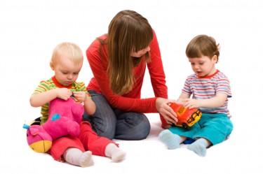
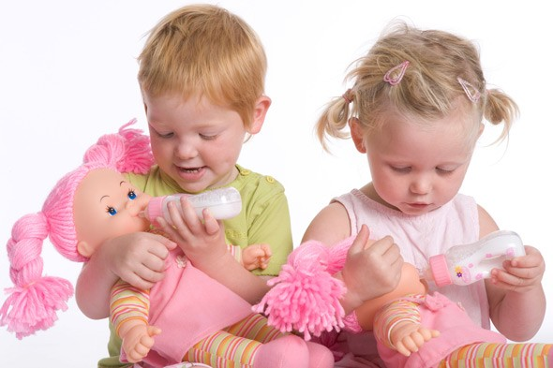
Play, pretending, symbolism, and growing minds cont.
Who advances children’s play? More sophisticated play partners
Adult
Older sibling
Scaffolding – greater play sophistication raises child’s level
Attunement (i.e., accurate emotional signaling and responsiveness) during first year predicts symbolic play ability in later years
Play develops in phases
Pretending to drink with cup – nine months
Conveying intention to stimulate or pretend – four years
Theory of mind implicated
Role shifting available
Theory of mind enhances play, and play enhances theory of mind
Link between storytelling and pretend play (Nicolopoulou, 1997)
Increasing attention to understanding character representation
Developing themes of how one event follows after another
These skills become integrated in the school years

Slide 10
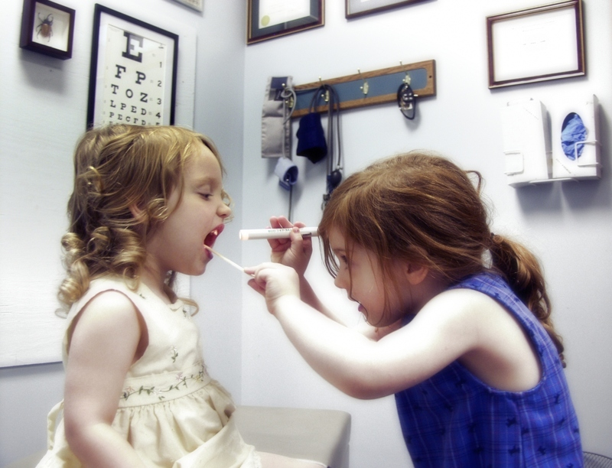
Summary
Symbolic play is associated with understanding others’ minds
Play helps children communicate their deepest desires and fears, thus making them available for understanding and processing
Play helps child to bracket here-and-now experience to participate in another reality
Children on the autism spectrum have difficulty playing

Slide 11
Boys, girls, and gender
Biological differences and rare conditions
Brain differences
Males – bigger, more lateralized (language in left hemisphere, visuospatial tasks in right hemisphere)
Females – more complex neuronal connections, less lateralized (language in both hemispheres)
Genital differences
Penis = clitoris
Scrotum = labia
Controlled by testosterone and estrogen released in utero
Hormones impact the brain
“masculine” brain and “feminine” brain
brain gender can differ from anatomical gender
When such a discrepancy occurs, the individual tends to identify with brain gender
Different styles of play and levels of aggression
Boys make less eye contact (look longer at mobile at birth)
Boys play more with cars and less with dolls

Slide 12
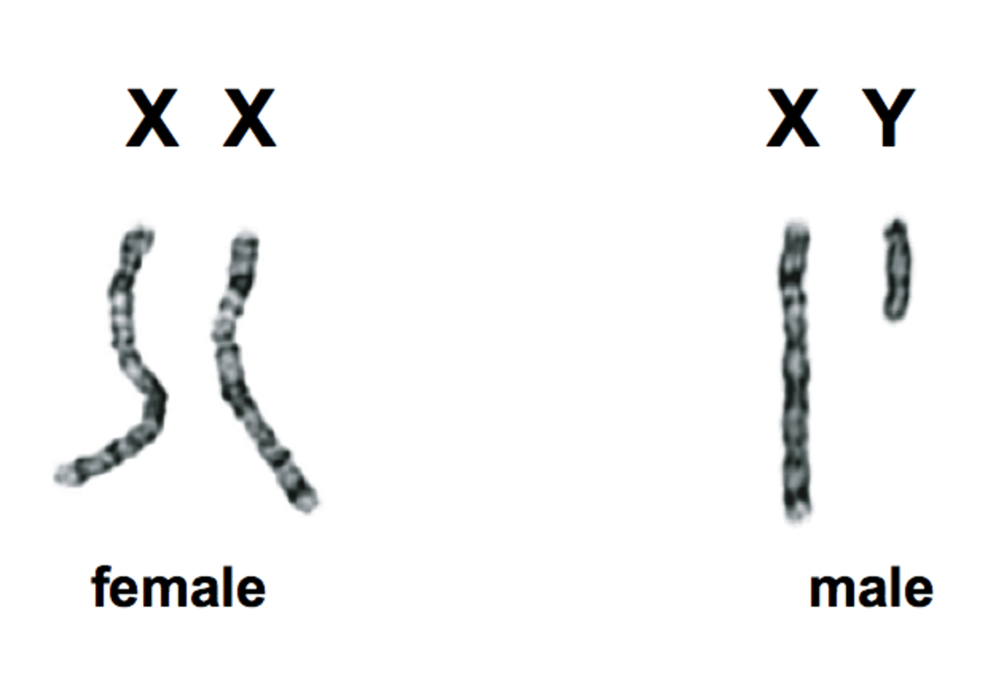
A weaker sex? Gender and the impact of early experiences
Males are more biologically vulnerable
140 males conceived for every 100 females
At birth, 105 males to 100 females
Males have a higher mortality rate
Males more likely to suffer from autism, Tourette’s, reading delays
Reasons for male vulnerability
Only one x chromosome, so less room for error
Males work harder and longer (although that is changing)
Males take more risks and are more aggressive
Reasons for girls’ invulnerability
Respond better to social stimulation
Better at affect regulation
Less adversely affected by disruptions in parenting
Depressed mothers respond more positively to girls
Males tend to externalize conflicts, while girls tend to internalize conflicts

Slide 13
Different cultures, different genders
Women’s discourse can be direct, assertive, even aggressive (gapun women of papua new guinea)
Xanith in omani act like a third gender
Passive homosexual relationships
Dress and act like women
Native American berdache
Male and female spirit in same body
Can have sexual relationships with either gender
Venus and mars: language and different planets
Mothers spend more time with and engage in more mutual eye contact with girls, perhaps accounting for girls’ greater verbal fluency
Girls tend to use more “hedges” (words to describe tentative meaning)
On playground, girls talk more, while boys engage in more activity

Slide 14
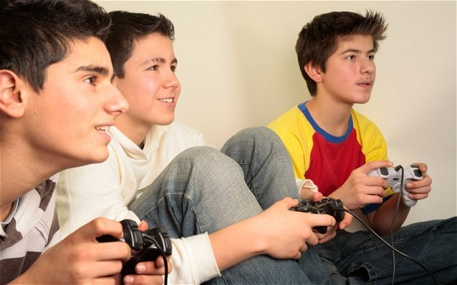
Preferred cultures, different gender preferences, and beliefs
Boys are preferred in most cultures for economic reasons
Girls are preferred for a bride price (dowry), which boosts the economy
Different genders, different psychological presentations
Girls are more likely to suffer from internalizing disorders – depression, anxiety, and eating disorders (but what about borderline personality disorder)?
Boys are more likely to suffer from externalizing disorders – adhd, odd, and cd
Boys are more risk-taking than girls to attract a mate (sexual competition)
Boys are more aggressive and evidence more violent themes in fantasies than girls

Slide 15
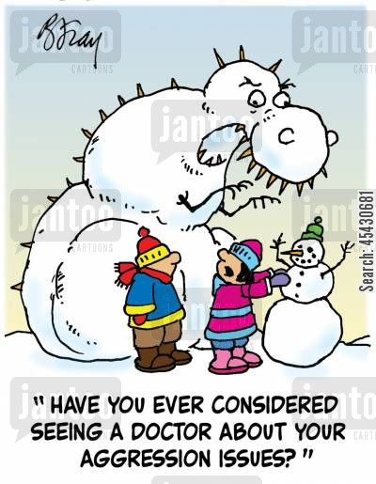
Testosterone again, and other hormones
Testosterone is associated with more violent crime, behavioral difficulties, and of course, being male
Testosterone is later associated with
Less job success
Less marriage success
Less politeness
Less smiling
Women with high testosterone evidence
More dominance
More aggression
More competitiveness
Fetal exposure to testosterone sensitizes the brain and helps to produce masculine traits
High Testosterone levels might make someone less amenable to parental (and societal?) influence
Culture plays a role in testosterone levels (at least in adulthood)

Slide 16
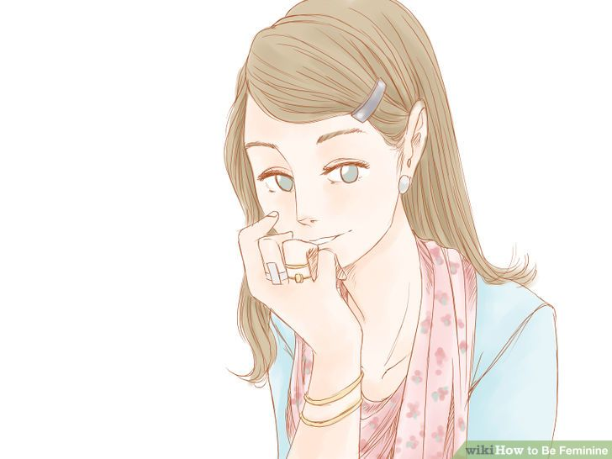
Social learning
Children identify with their gender by 3 years old, but others’ genders are still perceived as not fixed
Children ages 4 to 6 ascribe gender to superficial characteristics (hairstyle or clothes)
Children ages 6 and 7 view gender as stable and begin socializing in gendered groups
Women perform more poorly on intelligence tests and describe themselves in feminine ways when meeting a Man with a preference
for “traditional” women
Eat less
Speak in softer voice
Become less competitive
Adults respond differently to babies depending on gender of clothes and name
Rougher play for boys
Bigger bodily movements for boys
Encouragement to play with gender-typical toys
Gender-typical play is influenced by gender of older sibling
Media-produced gender stereotypes do strengthen actual gender stereotypes

Slide 17
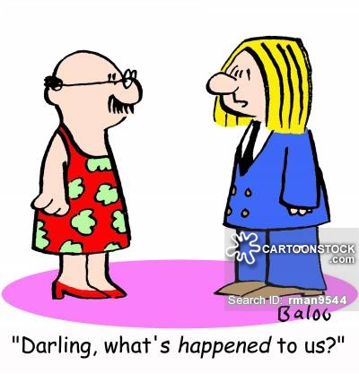
Summary: nature and nurture and fuzzy genders
Masculinity and femininity can be viewed as occupying two continua, not the opposite poles of one continuum
Biology and socialization become entwined quite early in development
It quickly becomes difficult to tease them apart

