Slide 1
Developmental Psychology
Dr. Geoff Goodman
Lecture 4
10/4/16

Slide 2
Empathy, self, and other minds
Early precursors of understanding other minds
Mind-mindedness (Elizabeth meins)
Parent’s acknowledgment of child’s mental states
Reflecting back to child what he or she is feeling and intending (i.e., wanting)
Marking – reflection of feeling (gergely)
Similar to the infant’s expression of feeling
Not too similar, however
Child outcomes of parental mind-mindedness
Empathy
Sooner understanding of others’ minds
An understanding of oneself through the eyes (i.e., mind) of caregiver
Development of mental representations of self and other
Pretend mode – “don’t be such a wimp” (i.e., invalidation)
Psychic equivalence mode – just two people feeling the same thing

Slide 3
Early precursors of understanding other minds cont.
Bion’s “alpha function”
Caregiver’s ability to convey understanding of infant’s emotions (especially negative ones)
Caregiver metabolizes or digests overwhelming emotions, thus detoxifying them
Winnicott’s good-enough mothering
Survive infant’s rage
Without crumpling, raging back, or withdrawing
Developmental timetable
At three months – infants can lead their “companion in meaning-making” toward areas of interest
At six months – infants can engage in complex game playing, including teasing
Later in first year – interest in one’s own reflection and developing self-awareness

Slide 4
Developmental leaps from nine months and onwards
Social referencing – reading caregiver’s facial cues to determine safety of environment
World interpreted through the eyes of the mother
Negative associations between dangerous situation and accompanying fearful emotion develop
Proto-imperative pointing – pointing to something infant wants with expectation of adult’s retrieval
Proto-declarative pointing – joint attention directed at something infant thinks adult would also find interesting
Children with autism
Deficits in joint attention skills
Deficits in theory of mind skills
Children who have suffered neglect or abuse
Less able to make sense of another’s mental states
More superficial understanding of others’ mental states
Fear of the contents of the neglectful or abusive caregiver’s mind (fonagy)

Slide 5
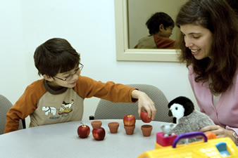
Theory of mind – capacity to take the perspective of another person
Understanding intentions, beliefs, feelings of others
Distinguishing these from our own (reflective mode)
Theory of mind tasks (false belief tasks)
Cow in a house
Pig in a tea box
Children less than 4 answer incorrectly
Timetable for theory of mind skills depends on
Emotionally attuned caregiving (mind-mindedness)
Having siblings close in age
Mentalization-based intervention
Can reading to a child enhance theory of mind skills?
Mentalization – the interpretation of behaviors of self and others as resulting from mental states
Related to self-regulation
Related to social competence

Slide 6
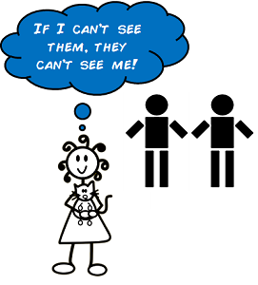
Expectations: the case of the autistic child
Fails false belief tasks
Brain circuits related to empathy are not used when a child with autism reads a story about a person’s feelings
Symptoms of autism
Severe social impairment – lacks understanding of feelings of self and others
Verbal and nonverbal communication difficulties
Absence of imaginary play, repetitive rituals
Children with autism use same areas of the brain to process faces and nonhuman objects
Autism-like symptoms found in children who have experienced extreme deprivation
Self-stimulation • Rocking • Inability to manage change (transitions)
• Limited verbal ability
• Little desire for closeness
• Little desire to seek comfort
• Difficulty understanding emotions – their own and others’
Similar behaviors associated with disorganized attachment

Slide 7
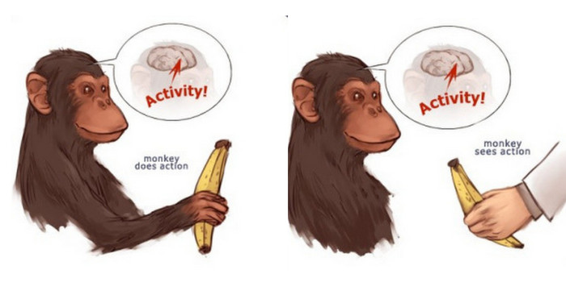
Empathy, mirror neurons, and rizzolatti’s monkeys
Firing of same neurons as those fired in someone person is observing
Crying because someone else begins to cry
Wincing when someone walks into a glass door
Mirror neurons facilitate capacity to form empathic connections between humans
Mirror neurons are found in broca’s area in the left hemisphere, a region central to language development (perhaps why “talk therapy” is so effective?)
Same phenomenon found in macaque monkeys (rizzolatti)
Children with autism have a deficit in mirror-neuron functioning

Slide 8
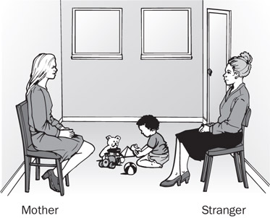
attachment
Attachment theory and john Bowlby and mary ainsworth
Observation of children separated from their parents
London blitz
Hospitalized children
Secure base – older, wiser person who provides protection when a threat is present
Exploration – discovery of the environment when the attachment system is deactivated by the secure base
Strange situation procedure (3-minute intervals)
Mother, infant, and observer (12 or 18 months old)
Mother and infant interacting
Stranger and infant interacting with mother present
Mother leaves and stranger alone with baby
Mother returns and stranger leaves
Mother leaves again and infant alone
Stranger returns and interacts with infant
Mother returns and interacts with infant

Slide 9
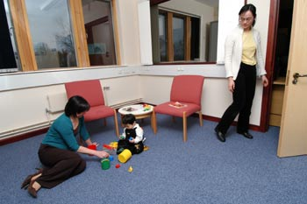
Attachment theory and john Bowlby and mary ainsworth cont.
Attachment classifications
B – securely attached
Infant cries during separation
Wary of stranger during separation
Proximity-seeking and contact-maintenance upon reunion
Settles quickly upon reunion
a – anxious-avoidant
Infant does not typically cry during separation
Interacts with stranger during separation
Snubbing of mother upon reunion
Appears settled but heart rate is high upon reunion
C – anxious-resistant/ambivalent
Infant cries hysterically during separation
Terrified of stranger during separation
Alternates between making bids to be picked up and consoled and pushing mother away in anger upon reunion
Cannot settle upon reunion

Slide 10
Attachment theory and john Bowlby and mary ainsworth cont.
D – disorganized/disoriented
Infant might or might not cry during separation
Might or might not be wary of stranger during separation
Bizarre, dissociated behavior upon reunion
Cannot settle upon reunion
Caregiver behavioral analogues of infant classifications
Emotionally responsive, available (b)
Dismissing, rejecting of needs (a)
Inconsistent, inept (C)
Abusive, neglectful, frightening or frightened (D)
Attachment classifications can now be predicted by 150 seconds of mother-infant interactions at four months (beebe)
Future b babies make eye contact, fully engage
Future a babies make less eye contact, sooth selves
Future c babies make eye contact but look fearful
Future d babies both escape gaze and look fearful

Slide 11
Attachment inside us
internal working model – set of nonconscious procedures or expectations of how others respond to one’s bids for engagement
Our experiences influence internal working models, but internal working models influence the interpretation of new experiences (creation of developmental trajectory)

Slide 12
Attachment inside us cont.
Adult attachment interview
Measures internal working models in adolescence and adulthood
Aai captures quality of the organization of the internal working model through a linguistic analysis of the interview transcription
Coherent, valid description of childhood relationships with parents (f)
Idealized, brief, unsubstantiated description of childhood relationships with parents (dS)
ANGRY, MEANDERING DESCRIPTION OF CHILDHOOD RELATIONSHIPS WITH PARENTS (E)
SOMEWHAT INCOHERENT, BIZARRE DESCRIPTION OF TRAUMATIC EVENTS OR LOSSES (U)
“earned secure” status – coherent description in spite of challenging childhood
Psychotherapy can change developmental trajectory
Romantic relationship
High reflective functioning (see psychotherapy)

Slide 13
Intergenerational transmission of attachment
Caregivers who respond sensitively to their infants tend to have infants who trust them when they feel distress
Caregivers who dismiss and reject their infants tend to have infants who become compulsively self-reliant
Inconsistent caregivers tend to have infants who feel anxious and unsure of their ability to solicit comfort and thus exaggerate their needs
Caregivers who frighten or are frightened by their infants tend to have infants who need them yet are frightened by them (approach-avoidance conflict)

Slide 14
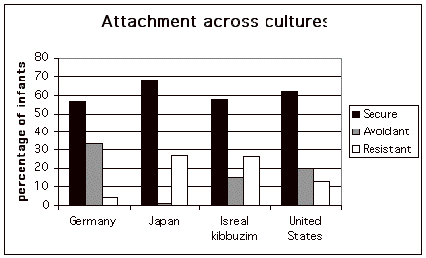
Attachment theory and culture
Percentage of attachment security tends not to vary across cultures
Percentage of the two types of attachment insecurity does tend to vary across cultures
Israeli kibbutzim (c)
Northern Germany (a)
Rural japan (c)
Caregiver sensitivity can be measured cross-culturally and is linked to attachment security cross-culturally (argument for universal phenomenon)
Copyright University of Boulder http://psych.colorado.edu/~colunga/P4684/incas12.html

Slide 15
Attachment and disorders
Attachment insecurity is considered a risk factor for some kinds of psychopathology
Attachment security is considered a protective factor
Disorganized attachment is probably a necessary but not a sufficient condition for reactive attachment disorder
Inhibited—reactive attachment disorder
Disinhibited—disinhibited social engagement disorder
Internal working models are increasingly resistant to change (argument for mother-infant therapy and child psychotherapy)

