Slide 1
Developmental Psychology
Dr. Geoff Goodman
Lecture 3
9/27/16

Slide 2
Born to Relate
Immaturity
Bonding begins at birth by sensing mother’s presence
Recognition of mother through sense of smell
Recognition of mother through sight
Bonding begins at birth by mother’s release of oxytocin
Maternal feelings of elation and love
Tolerance of higher pain thresholds
Reduction of risk of abandonment
Bonding begins at birth by mother’s release of vasopressin
Triggered by physical closeness
Triggered by breast feeding

Slide 3
Bonding: Humans are not grey-lag geese
No critical period for bonding
Humans can bond with genetically unrelated offspring
Bonding begins prenatally
Viewing ultrasound
Baby’s movements in utero
Other postnatal catalysts for bonding
Exaggerated facial features (e.g., anime eyes)
Release of prolactin in birth mothers and fathers
Increases protective feelings
Increases attentiveness
Mere proximity to one’s baby can increase affectional bonds
In 18th century France, mothers were forced to stay with their babies for eight days
Abandonment rate deceased from 24% to 10%

Slide 4
Wired to Relate
Infants respond to people differently than toys
Infants prefer mother’s face to stranger’s face
Evolutionary advantage of familiar over unfamiliar faces
Infants can also recognize familiar and unfamiliar voices
Babies can manipulate their sucking behavior to get certain familiar sounds or words repeated
Evolutionary advantage of locating secure base and eliciting appropriate care

Slide 5
Infant imitation and contingency
Two-day-old infants – imitate smiling, frowning, surprise (no intentionality yet, however)
Imitation allows conversational exchanges to take place
Infants learn from these exchanges
Sense of agency on external world developing
Idea of cause and effect developing
Contingency – cause and effect
0-3 months – perfect contingency
> 3 months – imperfect contingency
Expectations develop
Expectations sometimes violated
Partner needs to be attuned – but not perfectly

Slide 6
Attunement, affect regulation, and marking
Prompt, calm, attuned responsiveness – necessary ingredient for healthy development
Marking – slightly exaggerated reflection of infant’s feelings (Fonagy & Gergely)
Conveys understanding
Conveys containment
Mentalization modes
Psychic equivalence mode – perfect contingency, which is frightening (i.e., mirroring)
Pretend mode – noncontingency, which is reflecting back something different altogether
Reflective mode – reflecting the infant’s feeling through marking it as similar but not identical
Emotional responsiveness and marking
Less crying by one year of age
Feelings feel managed, regulated
Enhanced self-understanding
Enhanced affect regulation

Slide 7
Maternal instinct questioned: Abandonment and infanticide
When would evolutionary advantage favor infanticide?
Scarce resources for survival
Mitigation of high costs of child rearing
Cultural values differ from one culture to another
Younger mothers are more likely to abandon offspring than older mothers because they will have more chances
Does postpartum depression make it easier to abandon a baby whose mother has limited support and resources?

Slide 8
Entrainment, culture, and becoming one of us
Babies learn about their world through the level of attunement and promptness of response
The nature of caregiver response is culturally mediated
Caregivers ignore 46% of infant crying episodes in America
In some cultures, infant receives nipple 15 seconds after crying
when is infant crying life-saving, and when is it dangerous?
Infants adapt to whatever environment they are born into
What happens when environment changes (e.g., in adulthood)?

Slide 9
Infant Coping Mechanisms, Mismatches, and Repairs in Relating
Earliest Interactions
limited ability to self-regulate emotions
limited ability to understand others’ intentions
Babies want to avoid negative and uncomfortable experiences and optimize their chances of experiencing affect regulation

Slide 10
It takes two to tango: Blind babies, premature babies, and sensitive babies
Blind babies – vicious cycle
Mothers withdraw, babies then withdraw, mothers withdraw more, feeling more helpless
Vicious cycle can be broken with intervention and awareness of infant responses (e.g., legs kicking after vocalizing)
Premature babies
Associated with developmental risks (i.e., behavioral problems, low IQ, learning difficulties, peer problems, attentional difficulties, more demanding)
Mothers less confident, more anxious
Infants not biologically primed to cry before term
Infants less able to recognize caregiver’s voice
What contributes to favorable outcomes?
Physical attractiveness, no physical disabilities, time caregiver spends with infant, kangaroo care (infant carried upright under caregiver’s clothes), family support, caregiver attunement

Slide 11
Early emotional defenses (Fraiberg)
Freezing (18 months) – response to fear
Fight (end of second year) – “stubborn monsters”
Flight (withdrawal or avoidance) – overstimulated
Reaction formation – turning negative into positive affect
Mismatches and dodges
Attunement occurs 28% of the time at three months
34% of the time at nine months (Tronick)
Winnicott’s concept of “good-enough mothering”
Infants learn that misattunements can be repaired
Rupture–repair cycle can become expectation
Is this what good psychotherapy is all about (Alliance-Focused Therapy [AFT])?
34% of mismatches repaired by next interaction phase
36% of remaining mismatches repaired by second phase

Slide 12
Mismatches and dodges cont.
“Chase and dodge” interactions
Infants do not learn how to regulate themselves
Infants do not learn how to separate
Infants do not learn to trust their own bodily signals
Premature infants at particular risk for “chase and dodge” interaction pattern
Heart rates recover more slowly
Still-face paradigm
Infants with less sensitive mothers recover from paradigm more slowly, turn away more
Infants with more sensitive mothers regulate heart rates and manage negative affect better

Slide 13
The effect of maternal depression and other mental health problems
Increased risk of insecure attachment
Sleep problems, temper tantrums, separation issues by age 2
Problems with peer relationships
Greater passivity
Depression and anxiety in adolescent girls
Externalizing problems in adolescent boys
Depressed mothers lack
Ability to read baby’s signals
More unresponsive
In still-face paradigm, babies expect less from maternal interactions and thus fuss less with both mothers and more responsive others
Infants of withdrawn mothers spent only 5% of their time watching their mothers, preferring to stare into space
By age 3 – internalizing behaviors, little empathy, passive, withdrawn

Slide 14
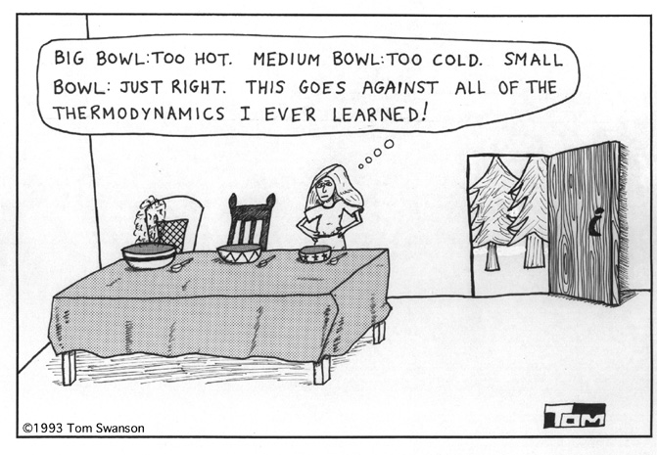
The effect of maternal depression and other mental health problems cont.
Borderline mothers
More controlling, particularly at meal times
Less aware of infant’s mental states
These mothers were more enmeshed with their own parents on the AA I
Socially phobic mothers
Infants learn to distrust and avoid strangers
Higher cortisol levels
Infants less secure in social world
“Goldilocks” phenomenon – neither too overstimulating nor too understimulating

