Slide 1
Developmental Psychology: Lifespan
Dr. Geoff Goodman
Class 2
9/20/16

Slide 2
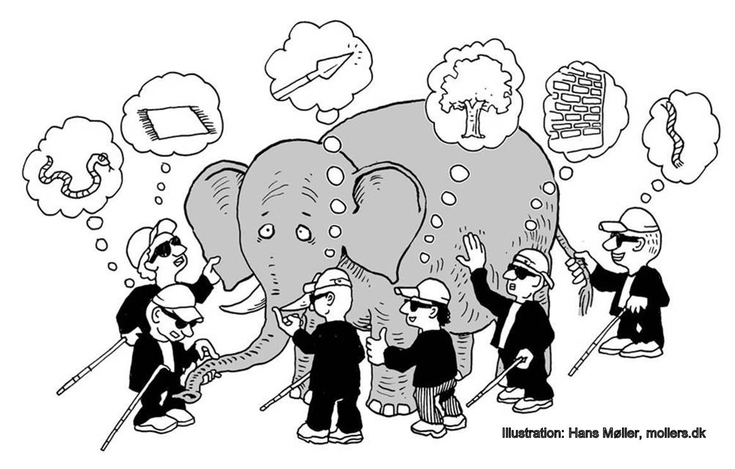
Introduction: The Blind men and The Elephant
The blind men and the elephant
perception determines reality! But what GENERATES our perceptions?

Slide 3
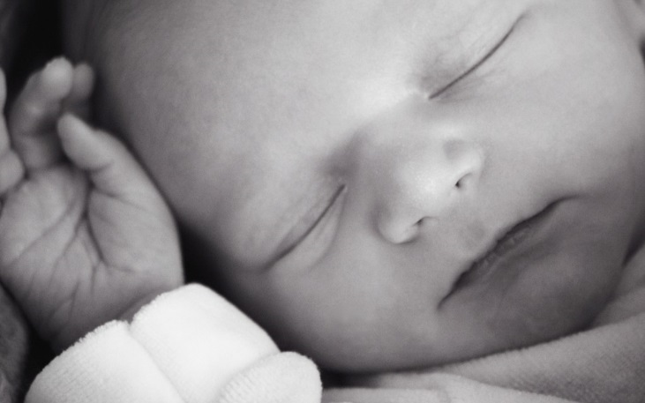
Introduction: The Blind men and The Elephant
A) Nature and Nurture
1) Humans are blank slates at birth (tabula rasa; john locke) 2) Humans have inherited psychological abilities (Immanuel kant) 3) Nature and nurture mutually influence each other throughout the life cycle
a) Winnicott—”there is no such thing as a baby” B) Bronfenbrenner—Ecobiological perspective
1) biological inheritance 2) Family system 3) school system 4) neighborhood system 5) societal mAcrosystem

Slide 4
Introduction: The Blind men and The Elephant
4) Moderational model a) genetics produces certain outcomes, but only under certain environmental circumstances B) childcare outcomes depend on: 1) type of childCARE (IN-HOME VS. OUT-OF-HOME) 2) quality of childcare 3) child personality type 4) child age 5) time spent in childcare 6) type of outcome (cognitive, emotional, social) C) adhd manifestation: 1) genetic predisposition 2) insensitive parenting 3) gene Variant + insensitivity + [gv * I] → adhd

Slide 5
Introduction: The Blind men and The Elephant
B) Multiple Perspectives
1) animal as well as human models
2) Quantitative (aggregated) & qualitative (personal, subjective experience)
3) Examining research with a critical eye
a) homosexuality found in dsm until 1973
B) Arthur Jensen—iq differences between blacks and whites are hereditary
C) un-nurtured children, feral children, and the lack of human input
1) experience dependence—brain Development differs depending on the kinds of experience one has
2) experience expectance—input humans are primed to expect
a) Kitten needs light for visual development at a critical period
b) humans require exposure to language and human contact at a critical period
C) particular experiences are needed to make people “properly” human
3) crucially, we need an experience of ourselves as reflected back through the eyes and minds of those around us—ONE’S sense of self is socially and co-constructed

Slide 6
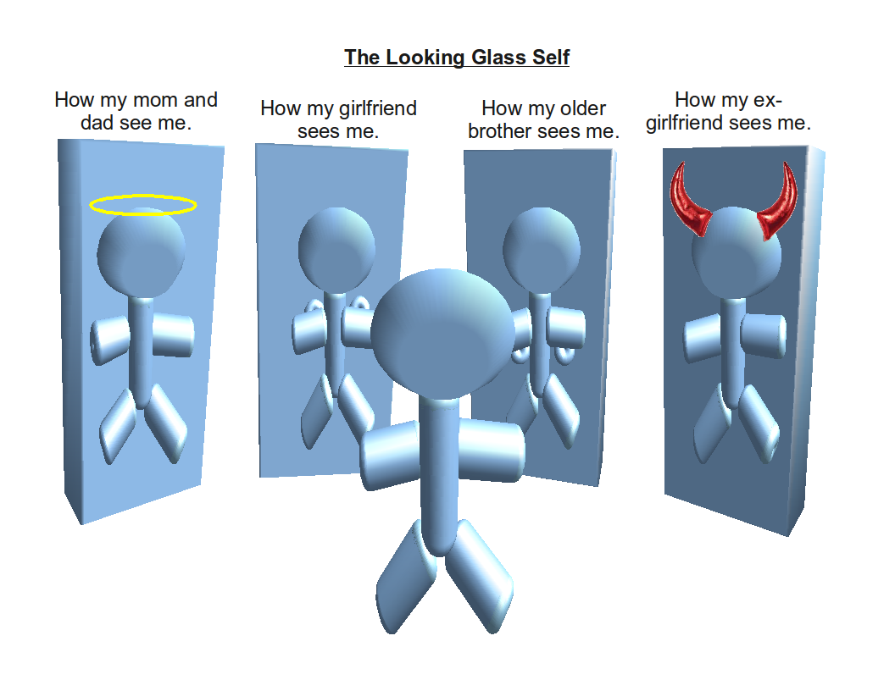
Introduction: the blind men and the elephant

Slide 7
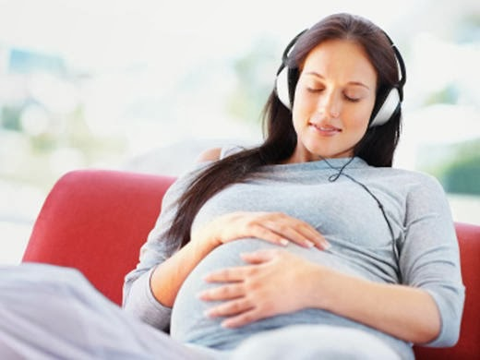
Life begins: from conception to birth
The fetus exerts control over the uterus 1) Positioning 2) Timing 3) Presentation for birth
b) THE FETUS IS ACTIVE AND RESPONSIVE
1) RESPONDS TO MUSICAL SIGNALS 2) JUMPS IF TOUCHED 3) HEART RATE RESPONDS TO CIGARETTE SMOKING, LOUD NOISES 4) SOUND RECOGNITION AFTER BIRTH OF SOUNDS HEARD BEFORE BIRTH 5) CULTURALLY INFLUENCED TASTES BEFORE BIRTH (E.G., GARLIC)

Slide 8
Life begins: from conception to birth
C) Mother’s state of mind influences prenatal environment via release of hormones
1) fetuses of depressed and nondepressed mothers react differently as detected by heart rates after introduction of acoustic stimulus 2) fetuses’ movements in utero differ depending on mothers’ depression type 3) mother influences fetus through hormone release, but mother’s body also develops unique response to fetal demands 4) genes express themselves differently depending on parental origin
a) in mice, genes from mother produce smaller, more intelligent offspring b) genes from father produce more muscular, less intelligent offspring

Slide 9
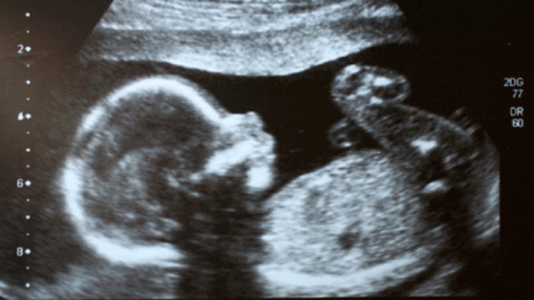
Life begins: from conception to birth
D) Observing the unborn baby 1) Twin behavior patterns in utero are observed postnatally 2) Personality traits develop in utero 3) Maternal emotional states such as stress and anger Might have pHYSIOLOGICAL effects mediated by maternal Hormones 4) some continuity between prenatal and postnatal life (piontelli’S WORK)

Slide 10
Life begins: from conception to birth
E) Where does parental influence start? The meeting of biology and psychology 1) Mother’s state of mind with respect to attachment during pregnancy predicts 12-month attachment security 2) Ability to reflect on childhood emotional experiences influences parenting responsiveness, which in turn influences perception of caregiver as secure base 3) Prenatal experiences have unique lasting experience A) Starving mothers produce children who have “thrifty” metabolisms and store fat (“fetal programming”) b) Low birthweight predisposes person to stroke, diabetes, AND heart disease

Slide 11
Life begins: from conception to birth
c) HIGH MATERNAL STRESS LEVELS IN UTERO RELATED TO: 1) BIRTH COMPLICATIONS 2) LOW BIRTHWEIGHT 3) POOR MEMORY 4) POOR HABITUATION
d) Cortisol mediates fear responses in both mother and fetus, even controlling for: 1) social class 2) diet 3) smoking
E) Embryos implanted In other women with higher stress levels have more behavioral problems later

Slide 12
Life begins: from conception to birth
f) Lasting effects, social effects 1) High maternal stress affects: A) Fetal brain structure and functioning B) Later mood and anxiety disorders C) High cortisol levels throughout the lifespan D) Permanently altered stress response system 2) Low birthweight makes child more susceptible to: A) Physiological effects of stress (e.g., reduced head circumference) B) Caused by poverty and unemployment C) Moderational model: Poverty/unemployment + low birthweight + [plu * lbw] → stress

Slide 13
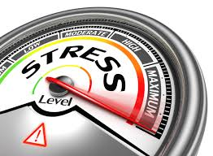
Life begins: from conception to birth
3) SEVERE ANTENATAL STRESS LOWERS DOPAMINE and serotonin, linked to: A) addiction B) depression C) anxiety D) adhd 4) critical period for effects of maternal anxiety: 12-22 weeks 5) programming effect of stress hormones during critical period 6) maternal support counteracts many of these negative impacts 7) do harsh environmental conditions influence female adolescents to mature earlier and have babies earlier and more often (fast life history strategies)?

Slide 14
Life begins: from conception to birth
G) Being born 1) Support before and after birtH A) Ease labor and delivery b) Reduce risk of birth complications C) Shorten labor and delivery D) Reduce caesarian sections E) Reduce meconium staining F) Reduce fetal distress G) Reduce likelihood of hospitalization in first six month H) Reduce likelihood of vacuum extraction or forceps i) Reduce need for drugs j) Increase satisfaction with birth experience

Slide 15
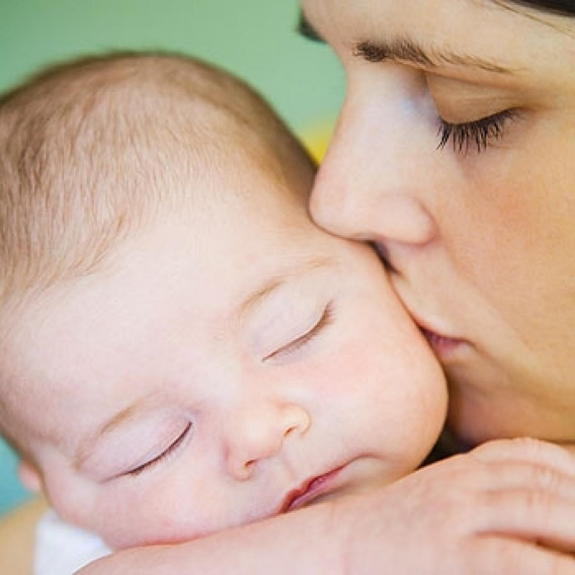
Life begins: from conception to birth
2) Oxytocin—Released at birth; aids in bonding with baby and reduction of pain 3) Difficult birth predicts later adult mental health problems such as adolescent drug use 4) Companionship and support for mothers smooth the birth process and reduce the risk of postnatal depression, making them feel closer to their infants

