Slide 1
Developmental psychology
dr. Geoff goodman
Lecture 12
11/29/16

Slide 2


Healing communities
Trauma – understood in context of human relationships
  What is traumatic about trauma? Shattering of human connections
  The personal face of trauma
    Being harmed by the people who are supposed to love you
    Being abandoned by the people who are supposed to love you
    Being robbed of one-to-one relationships that allow a child to feel safe and valued
  Recovery from trauma and neglect must also be about relationships
    Rebuilding trust
    Regaining confidence
    Returning to a sense of security
    Reconnecting to love
    Lasting, caring connections to others
    must comprise the context of therapy and medications
    Quality of therapist-patient relationship allows therapy to work beyond his or her methods or words of wisdom
  Recovery from trauma and neglect is not about
    Poorly trained mental health professionals
    Coercing child to “open up” or “get out the anger”

Slide 3
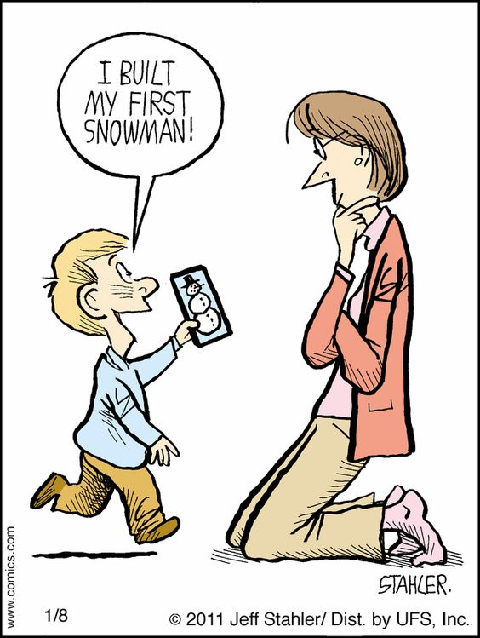
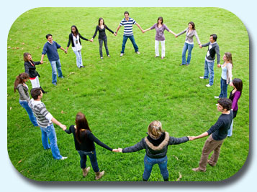
Building a healthier society
  Technology’s role in keeping us apart and eroding the extended family
  Historically, humans lived in small groups (40-150)
    Biologically related
    Communal living
  26% of americans live alone
    You cannot love yourself unless you have been loved and are loved
    The capacity to love cannot be built in isolation
    Depression rates have increased as the extended family has deteriorated
  How do we create a society that respects our biological needs and enhances our connections to others rather than ignores or disrupts them?
    Childcare workers are not allowed to touch children in California
    Children without healthy touch are more vulnerable to the advances of pedophiles
    Other ways our communities ignore our biological needs
      Keeping children inside
      No spontaneous play in neighborhoods with friends
      Rigid structuring of children’s lives
      Destroying community bonds

Slide 4


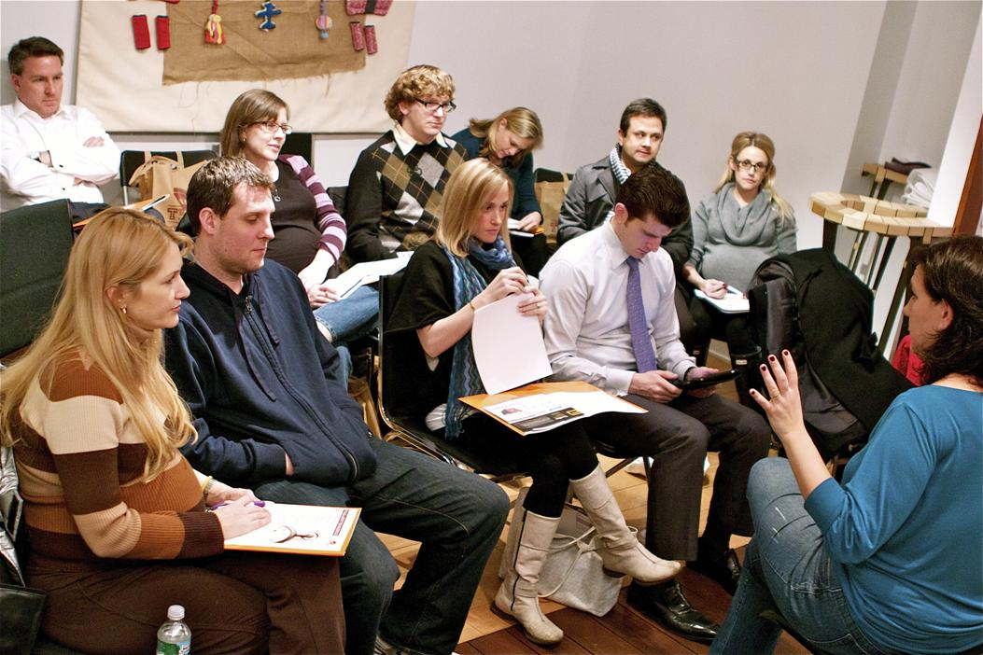
Building a healthier society cont.
  Current government policies and practices do not put relationships first
    Caregivers need daily support of a loving community that recognizes and relieves exhausting demands of parenthood
      Past – 4 adults/adolescents per child
      Today – good childcare center has caregiver/child ratio of 1:5
    Sleeping arrangements – source of sleeping/crying problems?
      Past – infants slept in same room with parents
      Today – infants sleep in their own rooms
    Parent education classes – mandatory like health class?
    Paid family leave and free high-quality childcare
      (see where to invade next)

Slide 5


What steps can parents and schools take to protect their children’s relationships?
  Set boundaries on media and technology
    Regular family meals without distractions
    Modeling empathy and kindness in relationships
  Obsessive focus on cognitive development at expense of
  children’s emotional and physical needs
    Mid-1980s
      Lunch periods
      Recess times
      Gym, music, and art classes
      One hour of homework/night
      Children responsible for remembering and meeting
      deadlines on their own
      Only a few projects requiring parental assistance/year
      Recognition of free time to run, play, and socialize

Slide 6


What steps can parents and schools take to protect their children’s relationships cont.
  Today
    Rigid curricular structure
    No recess times
    No time for friendships, play, or daydreaming
    Disrespect for importance of relationships
    undermines the development of empathy
  The cost of the failure of schools – compromised brain development
    Brains will be underdeveloped
    Children no longer learn how to be with others
    Children no longer learn how to work through conflict
    Children no longer learn how to negotiate complex social hierarchies
    Children’s brains need a modicum of stress – not too much or too little
      Schools and parents fetishize safety
      Schools and parents protect children from suffering the consequences of their actions
      But schools also punish children (e.g., expulsion) with
      potentially lifetime consequences

Slide 7
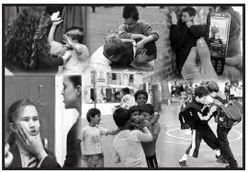

What steps can parents and schools take to protect their children’s relationships cont.
  School violence
    Parental abuse, economic inequality, violent neighborhoods probably have a greater influence than
    Violent video games and violent television
Foster cooperation and altruism rather than competition
  Cooperation has fostered survival
  Cooperation under threat in modern capitalism and
  global competition
  Need to make everyone feel included
Early intervention is superior to later intervention
  Fewer reinforcements experienced
  Small decisions accrue that place progress out of reach
  Punishment does not work as an intervention because it
  cannot create or model qualities of kindness, giving, and empathy
  Positive feedback loops need to be established

Slide 8


What steps can parents and schools take to protect their children’s relationships cont.
  Safety and love are prerequisites for lasting change
  Threats to withdraw love cannot provide long-term, internal motivation that will provide more behavioral control
  Only patient, loving, consistent care works; “there are no short-term miracle cures” (perry & Szalavitz, 2006, p. 245)
  Punishment can actually retraumatize children and exacerbate their problems
  The most effective intervention for calming and centering a child is
  to calm and center ourselves and simply pay attention
  Interventions that group disruptive, impulsive children together are ineffective because they mirror each others’ behavior
  Duration and intensity of the trauma is proportional to the number
  of repetitions required for recovery
  Because trauma renders its victims helpless, intervention must allow patient to be in charge of key aspects of therapeutic interaction
  Coercive therapies are dangerous and ineffective for victims of trauma

Slide 9

Research paper pointers
Method section
  Participants
    Sample size
    Race/ethnicity percentages
    Gender percentage
    Age (range, mean, and standard deviation)
    Educational level (range, mean, and standard deviation)
    Annual income (range, mean, and sd) or socioeconomic status (hollingshead index)
    Marital status (if applicable)
  Procedure
    How did you conduct this study?
    Irb-approved study
      Parents signed consent forms • Children signed assent forms
    Coding teams coded data
      Independently of each other
      Blind to the hypotheses under study
      Established interrater reliability at .80 or above

Slide 10

Method section cont.
  Measures
    Length of time to administer measure
    Scoring
      Number of items in the measure
      Number of anchor points (e.g., 5-point likert-type scale) and anchor-point labels
      Range of possible scores
    Psychometric data
      Validity
      Test-retest reliability
  Data analysis
    Mediational model
      Pearson correlations
      Hierarchical regression analysis
    Moderational model
      2-way anova (analysis of variance)
      Ancova (analysis of covariance)

Slide 11
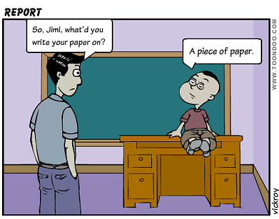
Results section
  Significant results at p < .05
  Nonsignificant results at p ≥ .05
Discussion section
  Discussion of significant results
  Discussion of nonsignificant results

