Slide 1
Child and Adolescent Psychopathology
Topic: Emotion Regulation

Slide 2
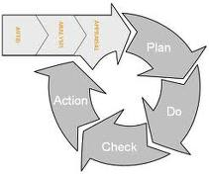
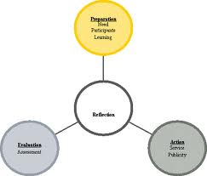
Emotion Dysregulation as a Risk Factor for Psychopathology
Two emotional processes
Appraisal – radar through which we evaluate circumstances in regard to their significance for well-being
Action preparation – readiness to respond in a particular manner that enables us to act to regain or maintain well-being

Slide 3
Emotion Dysregulation as a Risk Factor for Psychopathology
Purpose of emotions – to organize adaptive responses to shifting environmental circumstances
Rapid detection of threat
Continual, not occasional, states of arousal
Signals to changes in the environment related to their significance of well-being
Operating outside of conscious awareness
Inherently regulatory – motivating and readying particular types of action aimed at specific ways of changing the relation of the person to the environment
Focus attention
Facilitate or limit memory processes
Facilitate specific motor activities

Slide 4
Emotion Dysregulation as a Risk Factor for Psychopathology
Emotion regulation
Definition – changes in an initial emotional response toward modulation
Shift attention
Recall memories that intensify or reduce the emotion
Reappraise the situation
Take instrumental action

Slide 5
Emotion Dysregulation as a Risk Factor for Psychopathology
Examination of emotion regulation
Observation of temporal sequences
Convergence of information based on multiple levels of measurement
Behavioral
Self-report
Physiological
Strategic manipulations of situational context (Milgram experiment)

Slide 6
Emotion Dysregulation as a Risk Factor for Psychopathology
Emotion dysregulation
Emotional symptoms – “stable patterns of emotion regulation that have particular problematic features even as they serve the goals of achieving an immediate sense of well-being”. (p. 270-271)
Advantage – limits psychological discomfort
Disadvantage – diminished quality of relationships, productive activity, future developmental goals
Implicated in many forms of psychopathology – CD, depression, anxiety disorders, bipolar disorder, BPD, eating disorders, addictions

Slide 7
Emotion Dysregulation as a Risk Factor for Psychopathology
Four kinds of emotion dysregulation
Emotions endure, and regulatory attempts are ineffective
Emotions interfere with appropriate behavior
Emotions expressed or experienced are context-inappropriate
Emotions change too abruptly or too slowly

Slide 8
Emotion Dysregulation as a Risk Factor for Psychopathology
Characteristics of emotion dysregulation
Emotions endure, and regulatory attempts are ineffective
Lack of skillfulness in executing a regulatory strategy
Dysregulation of biological systems that support emotion
Secondary or partial gains for sustaining prolonged emotion

Slide 9
Emotion Dysregulation as a Risk Factor for Psychopathology
Strategies for regulating enduring emotions
Self-directed efforts to modify internal state (e.g., attention redirection, reappraisal, self-soothing)
Outward-directed efforts to alter circumstances (e.g., active problem-solving, information, support-seeking)
Responsiveness to efforts of others to soothe, redirect, or discourage emotional expression
Maladaptive strategies (e..g., avoidance, denial, emotion suppression, rumination, substance use, aggression, venting)

Slide 10
Emotion Dysregulation as a Risk Factor for Psychopathology
Factors that influence self-regulatory effectiveness in early childhood
Intensity of initial emotional response
Availability of child’s caregiver
Type of emotion experienced (e.g., problem-solving and self-distraction work for anger but not for fear)
Emotion regulatory strategies are used ineffectively by children with anxiety, depression, or behavior disorders

Slide 11
Emotion Dysregulation as a Risk Factor for Psychopathology
Emotions interfere with appropriate behavior
Emotions that produce behavior that violates social standards or compromise developmental goals
Emotions can disorganize behavior through their sheer intensity
Emotions can trigger other emotions that produce inappropriate behavior (.g., sadness →anger →aggression)
Two ways of understanding emotional responses
Externalizing disorders – less complex, less differentiated
Internalizing disorders – less differentiated for fear-eliciting circumstances only, refer to sadness in anger-eliciting contexts, and invoke cognitive states (e.g., confusion)

Slide 12
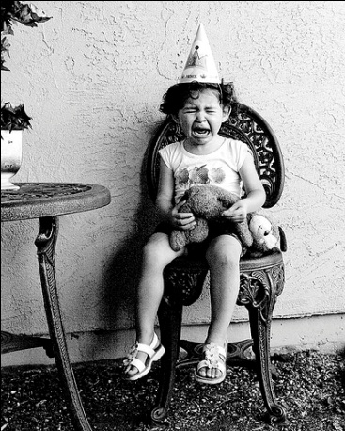
Emotion Dysregulation as a Risk Factor for Psychopathology
Emotions expressed or experienced are context-inappropriate
Positive and negative emotions can be contextually inappropriate
Individual differences in emotional responses beyond situations
Developmental level influences meaning of situational context
Differentiation of major emotions (anger, joy, sadness, fear) by end of first year
Infant emotional expressions conform to social expectations by one year

Slide 13
Emotion Dysregulation as a Risk Factor for Psychopathology
Three types of context-inappropriate emotion
Inappropriate expression of emotion that fits context
Violates social or cultural norms for situation
Lack of social awareness
Disregard for social display rules (and effect on others)
Inability to regulate expression even when one wishes to do so
Emotional responses atypical in the context
Deviant forms of emotional reactivity or distorted attributions
Hostile attributional bias
Schadenfreude among ODD preschoolers and mothers
Linked to anxiety symptoms – dysregulated fear

Slide 14
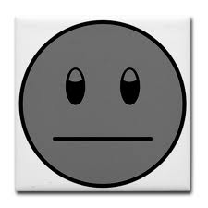
Emotion Dysregulation as a Risk Factor for Psychopathology
Lack of emotional responsiveness to an evocative situation
Key characteristics of CD, schizophrenia, depression, PTSD
Emotional unresponsiveness to particular context or generalized flatness of affect
Experiential avoidance
Emotions change too abruptly or too slowly
Rapid onset of emotions
Rapid of frequent change in emotion
most common with BPD and bipolar disorder
ODD preschoolers express anger when disappointed, intensified when experimenter leaves room

Slide 15
Affective Style and Risk for Psychopathology
Conceptual models of affective style
Valence model – positive and negative affectivity based on greater left or right frontal brain activity
Motivational model – greater left frontal brain activity associated with approach-oriented affect (e.g., joy, anger), while greater right frontal brain activity associated with avoidance-oriented affect

Slide 16
Affective Style and Risk for Psychopathology
Affective style, EEG Asymmetries, and Psychopathology
Moderational model – affective state X stress → psychopathology
Episode markers – asymmetries exist only during episode
Liability markers – asymmetries exist at all times
Genetic vulnerability markers – asymmetries entirely under genetic control
Independent of situational factors
Present in both depressed and nondepressed individuals

Slide 17
Affective Style and Risk for Psychopathology
Moderational model –
9 months affect X 9 months R frontal activity → social wariness at 4 years
Capability model – affective styles are emotion-regulatory abilities, not passive emotional predispositions
Frontal EEG asymmetry and time
Risk time to peak
Peak amplitude
Recovery time (e.g., depressed people “hold on” to longer activation

Slide 18
Affective Style and Risk for Psychopathology
Attachment Theory and Emotion Regulation
Appraisal – radar through which we evaluate circumstances in regard to their significance for well-being
Secure – modulated emotion regulation
Avoidant – deactivated attachment system (overregulation)
Resistant – hyperactivated attachment system (underregulation)
Disorganized – absence of strategy (dysregulation)

Slide 19
Affective Style and Risk for Psychopathology
Psychopathology associated with four patterns of attachment
Secure – neuroses
Avoidant – NPD, APD, substance abuse, anorexia nervosa
Resistant – BPD, HPD, depression, bulimia nervosa
Disorganized – BPD, PTSD, substance abuse

