Slide 1
Child & Adolescent Psychopathology

Slide 2
Impulsivity and Vulnerability to Psychopathology
Trait impulsivity underlies several externalizing disorders
ADHD
ODD
CD
APD
Substance use disorders (SUDs)
This trajectory can also culminate in depression and internalizing psychopathology
Trait impulsivity – dysfunction in at least one of two inhibitory systems
Motivational inhibition – behavioral suppression in the context of anxiety-provoking cues
Executive inhibition – deliberate process of stopping of suppressing a task in appropriate response

Slide 3
Impulsivity and Vulnerability to Psychopathology
DSM-IV criteria for impulsivity in ADHD
Impatience
Difficulty in delaying response
Blurting out answers before the questions have been completed
Difficulty awaiting one’s turn
Frequently interrupting or intruding on others
Impulsivity – “behavior that is socially inappropriate or maladaptive and is quickly emitted without forethought” (Oas, 1985; p. 142)

Slide 4
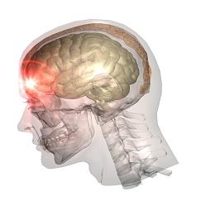
Impulsivity and Vulnerability to Psychopathology
Etiological formulations
Brain injuries – head trauma, hypoxia, and other CNS insults
Exposure to teratogenic agents – alcohol, stimulants, lead
Early traumatic experiences – social deprivation, abuse, neglect
Genetic vulnerabilities – deficient executive control over behavior
Difficult to distinguish temperamental impulsivity from environmentally based impulsivity (think: SuperNanny)
Heritable compromises in early maturing brain functioning alter neurodevelopment of later maturing brain functioning responsible for executive functioning and planning

Slide 5
Impulsivity and Vulnerability to Psychopathology
Temperamental impulsivity and central dopamine (DA) functioning
Mesolimbic dopamine system
Ventral tegmental area
Projections to the nucleus accumbens
Projections to other dopaminergic networks within the CNS
Trait impulsivity caused in part by abnormally low central DA activity
Behavior genetics of impulsivity
Concordance rates of impulsivity and ADHD – 0.8 heritability (80% genetic)
Externalizing disorders – 81% genetic, reflecting trait impulsivity

Slide 6
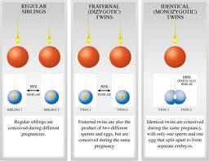
Impulsivity and Vulnerability to Psychopathology
Molecular genetics of impulsivity
Linkage studies – search for genetic markers with known chromosomal locations among large numbers of families
Genetic association studies – begins with candidate gene thought to play etiological role in expression of disorder
Allelic frequencies of specific genetic polymorphisms compared among those with and without the disorder
DRD4 gene and DAT1 gene implicated in the pathophysiology of impulsivity through DA expression
DBH, MAO, COMT genes also implicated in the pathophysiology of impulsivity through DA synthesis and metabolism

Slide 7
Impulsivity and Vulnerability to Psychopathology
Behavioral disinhibition and behavioral inhibition have almost completely non-overlapping neural substrates
Inhibition mediated by septal-hippocampal system
Septo-hippocampal system suppresses approach behaviors under threat
A person could be high on one construct and low on the other
INHIB.
INHIB.
DISIN.
Protected (buffered)
APD
DISIN.

Slide 8
Impulsivity and Vulnerability to Psychopathology
Cont’d
Anxiety helps ADHD children be more responsive to intervention
Implications for psychotherapy
Implications for medication
Psychopathy – combination of excessive approach behaviors and disturbing lack of anxiety and fear
Trait x trait interaction – two independent heritable attributes contributing to behavioral functioning

Slide 9
Impulsivity and Vulnerability to Psychopathology
Environmental risk for impulsive children
Parenting – negative, lax, verbose, overreactive in discipline
Hyperactivity + nagging, explosive parenting + hyper.*paren→externizaling disorder
Impulsivity causing coercive parenting?
Parental interventions ameliorate impulsivity
Child abuse and neglect
Impulsive children at higher risk for abuse and neglect
MAO gene + maltreatment + MAOgene*maltx→APD (in males)
Neighborhood effects
Impulsivity + low SES + impulsivity*low SES→violent crimes (in boys)

Slide 10
Impulsivity and Vulnerability to Psychopathology
Epigenetic and other experience-dependent effects
Environmental experiences influence gene expression
Epigenetic effects included in theoretical models of antisocial behavior
Neural plasticity – experience-dependent functional changes in neural networks, including efficiency, sensitivity, and time course of responding
Strong stimulants produce changes in neural functioning
Repeated maternal separations produce greater sensitivity to behavioral effects of cocaine and amphetamines later in rats
Stress also prevents maturational processes from unfolding
Implications for learning – efficiency of knowledge acquisition
Sensation-seeking tendencies that reduce learning motivation
Reduced efficacy of learning due to dampened activation of mesolimbic structures
Compromised executive functioning

Slide 11
Behavioral Inhibition as a Risk Factor for Psychopathology
Three categories of risk
Childhood experiences – excessive uncertainty, anger, sadness, shame, guilt provoked by abuse, neglect, divorce
Historical/cultural setting (e.g., views on martyrdom)
Biological biases
Temperaments – “biologically based foundations for clusters of feelings and actions that appear during early childhood and are sculpted by the environment into a large but limited number of profiles that ultimately define a personality.” (p. 160)

Slide 12
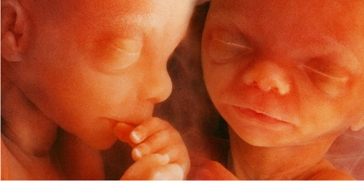
Behavioral Inhibition as a Risk Factor for Psychopathology
Heritable and nonheritable factors
Short allele of 5-HTTLPR
Nonheritable alterations in brain chemistry (female twin gets androgens from brother and later has high pain threshold)

Slide 13
Behavioral Inhibition as a Risk Factor for Psychopathology
Inhibition – high reaction to unfamiliarity
Moderately stable throughout the lifespan
Temperamental biases subordinate to historical/cultural influences
Sources of worry – encountering unfamiliar people, places, or situations, uncertainty about future (contrasted to performance anxiety in sports or academia)
Religious commitment can provide sense of certainty for highly reactive persons
Frequent exposure to specific unfamiliar phenomena can produce phobias to these phenomena (p. 169)

Slide 14
Behavioral Inhibition as a Risk Factor for Psychopathology
Diagnoses related to behavioral inhibition
Social phobia
Depression
Anhedonia
Biological bias
Preference for materialistic explanations
“No one is supposed to blame a victim” (p. 173)
New technologies for geneticists, molecular biologists, and neuroscientists
More focus should be on environmental presentation (p. 174)

