Slide 1
Child and Adolescent Psychopathology PSY 860
Topics of focus: Maltreatment and Neurodevelopment

Slide 2
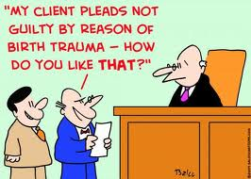
Maltreatment: Trauma and Neglect
Increased risk for psychopathology
Principle of multifinality – maltreatment as a risk for psychopathology, from Schizophrenia and Autism to ADHD and LDs
Trauma/abuse causes alterations in brain systems that mediate the stress response
Neglect causes dysfunctions in the neural systems that do not receive appropriately timed and patterned stimulation.

Slide 3
Definitions of Neglect and Trauma
Neglect – “The absence of an experience or pattern of experiences required to express an underlying genetic potential in a key developing neural system.” (p. 94)
Trauma – “An experience or pattern of experiences that activate the stress-response systems in such an extreme or prolonged fashion as to cause alterations in the regulation and functioning of these systems.” (p.94)

Slide 4
Impacts of Maltreatment on Development
Primary mediator of psychopathology
Neglect →Attachment disorder
Trauma→ PTSD
Exacerbating role in genetic expression
Neglect→ Depression
Trauma→ Schizophrenia
Symptoms caused by maltreatment can disrupt subsequent development
Neglect→ Attachment disorder→ social development
Trauma→ PTSD→ academic functioning

Slide 5
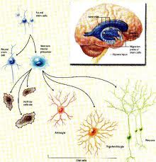
Neurodevelopment
Neurogenesis– cell birth
Takes place mostly in utero
Influenced by prenatal drug and alcohol use
Migration – movement of neurons to different parts of the brain (e.g., brainstem, cortex)
Affected by environment and genetics
Takes place mostly in utero
Differentiation – maturation of neurons to thousands of unique structures
Produce over 100 neurotransmitters
Extreme stress response during development can change the ways certain neurons differentiate, which in turn alters functional capacity of neural networks

Slide 6
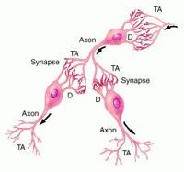
Neurodevelopment (cont’d)
Apoptosis – cell death
Stimulated neurons survive (neurons make synaptic connections with other neurons)
Understimulated neurons die
Arborization – density of dendrite branches that constitute receiving sites of neurotransmission from presynaptic neurons that process and integrate complex patterns of input
Synaptogenesis – development of synapses that regulate activity chains of neurons that allow all brain function
First eight months – eightfold increase in synaptic density
Flexibility to organize and function with wide range of potential
Remarkable vulnerability to trauma and neglect at this time

Slide 7
Neurodevelopment (cont’d)
Synaptic sculpting (“pruning”)
Synaptic connections strengthen and increase with use
Synaptic connections dissolve and die with disuse
Rate of sculpting decreases with age
Myelination – specialized glial cells wrap around axons and create more efficient electrochemical transduction down neuron
Allows neural network to function more rapidly and efficiently
Begins in first year but continue throughout life
Major burst in cortical areas in adolescence and continue until age thirty
Neglect can negatively influence myelination

Slide 8
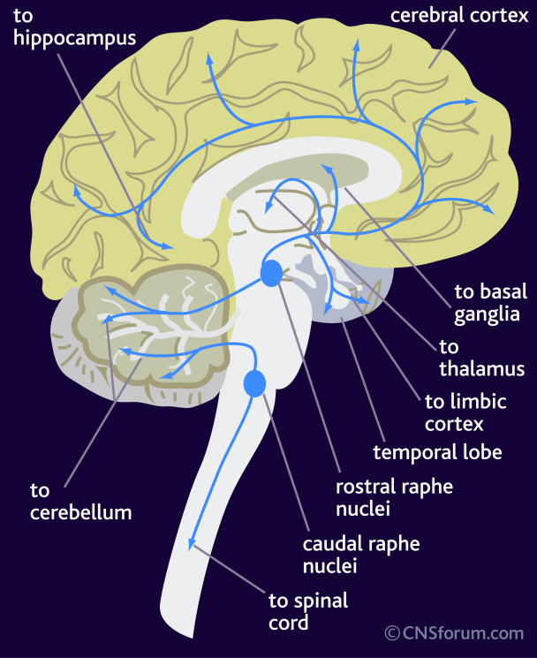
Principles of Neurodevelopment
Input of experience shifts across the lifespan
Brain develops in sequential and hierarchical fashion
From least complex region (brainstem) to most complex region (cortex)
If these systems are poorly organized and dysregulated, they can disorganize and dysregulate later-developing parts
Traumatic stress can influence cortically mediated, limbic-mediated, diencephalic- mediated, and brainstem-mediated functioning
Causes of disruption of critical neurodevelopmental cues
Lack of sensory experience during sensitive periods (e.g., neglect)
Atypical or abnormal patterns of necessary cues due to extremes of experience (e.g., traumatic stress)

Slide 9
Principles of Neurodevelopment (cont’d)
Early deprivation or trauma may be unable to overcome
Sensitive and critical windows – times when developing neural systems are more sensitive to experience than they are at other times
Acquisition of language
Formation of key relational and attachment capacities after age five becomes difficult
Different parts of brain differentially affected by experience at different times of development
Brainstem – in utero
Cortex – childhood and adolescence
Early childhood trauma potentially more damaging than similar trauma or neglect later in life
Duration, intensity, frequency, and onset of trauma important for understanding severity of psychopathology

Slide 10
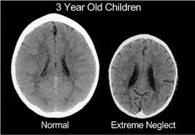
Neurodevelopmental Impact of Neglect
Chaotic, mistimed, inconsistent experiences related to primary caregiver’s isolation, personal chaos, and/or psychopathology
Frightened or frightening parenting behaviors at reunion
Disorganized attachment behaviors
Results in delays in motor, self-regulatory, affective, and cognitive function as well as in language acquisition
Changes in brain development
Smaller brains
Less arborization of dendrites
Sensory experiences required for optimal organization and development of parts of brain mediating specific functions (e.g., visual input during development of visual cortex)
Age at adoption positively correlated with resistance to recovery and pervasiveness of deficits

Slide 11
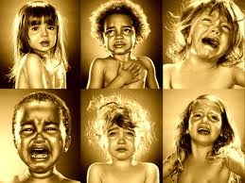
Neurodevelopmental Impact of Trauma
Incoming information alters homeostasis, then brain initiates compensatory, adaptive responses to reestablish homeostasis or take necessary actions to survive
Brainstem monoamine systems in the reticular activating system (RAS) provide flexible and diverse functions necessary to modulate stress, distress, and trauma
Amygdala and hippocampus are key brain structures in this process

Slide 12
Heterogeneity of Adaptive Responses to Threat: Hyperarousal and Dissociation
Hyperarousal – “fight or flight” response
“Plan B”: Dissociation – withdrawal of attention from external events and focus on internal experience (fantasy; see movie Precious) in which child assumes special powers
Different neurobiological pathways are involved in these two responses
For most children and adults, the adaptive response to an acute trauma is a mixture of both
Extreme, persistent trauma can convert fear into persistent anxiety
Functional problems exacerbated by disrupted family systems, poverty, and other contextual risk factors within which abuse and neglect are often embedded
Understanding underlying biological processes should result in a more advanced classification system and more effective intervention strategies

