Slide 1
Bipolar Disorder
&
Autism Spectrum Disorders:
A Developmental Perspective
Chapters 18 and 19
Child and Adolescent Psychopathology

Slide 2
Bipolar I Disorder
Episode of unipolar depression
Episodes of mania: enthusiasm, boundless energy, impulsivity, poor judgment
Intervals between episodes
Chronic course of illness
Occasional psychotic features: A/V hallucinations, delusions
Mood-congruent: emphasizes one’s powers or importance
Mood-incongruent: not related to inflated self-worth
Occasional mixed episode: features of depression and mania co-occur, which is treated psychopharmacologically as a manic episode

Slide 3
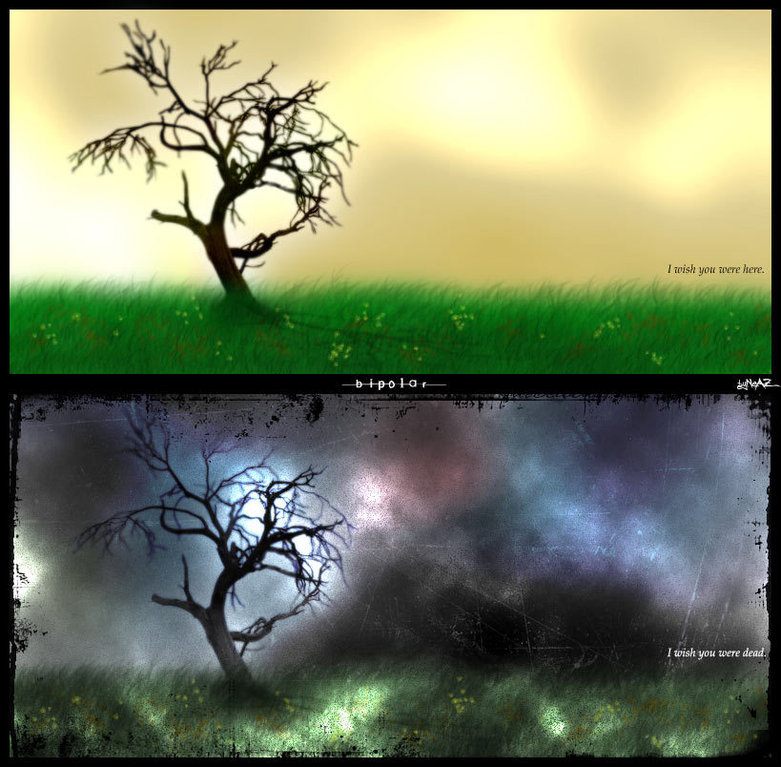
Variations from standard bipolar disorder in adulthood
Hypomania: less severe than mania, less functional impairment
Bipolar II disorder:
-Depressive and hypomanic episode with NO mania
-Rapid, intense mood shifts (rapid cycling) - episodes exceeds four per year

Slide 4
BIPOLAR DISORDER DEFINITIONS
BIPOLAR I DISORDER
MIXED EPISODE
BIPOLAR II DISORDER
RAPID CYCLING
In JUVENILE LIT
BIPOLAR NOS
ULTRARAPID CYCLING
ULTRADIAN CYCLING
MANIC (OR MIXED) EPISODE FOR AT LEAST 7 DAYS (UNLESS PSYCHOSIS IS PRESENT OR HOSPITALIZATION IS REQUIRED)
DOES NOT REQUIRE EPISODES OF DEPRESSION
EPISODES ARE A DEPARTURE FROM NORMAL BEHAVIOR
TYPICAL ONSET: YOUNG ADULTHOOD
IN THE PEDIATRIC LITERATURE, DURATION CRITERIA FOR MANIA IS NOT SPECIFIED
BOTH MANIC AND DEPRESSIVE SYMPTOMS FOR 7 DAYS OR MORE
PERIODS OF MAJOR DEPRESSION AND HYPOMANIA (EPISODES LASTING AT LEAST 4 DAYS)
NO FULL MANIC OR MIXED MANIC EPISODES
AT LEAST FOUR MOOD EPISODES IN 1 YEAR
MOOD CHANGES WITHIN AN EPISODE
CASES THAT DO NOT MEET FULL CRITERIA FOR OTHER BIPOLAR DIAGNOSES
FREQUENT MANIC EPISODES LASTING HOURS TO DAYS, BUT LESS THAN THE 4-DAY PREREQUISITE FOR HYPOMANIA
> 5-365 CYCLES PER YEAR
REPEATED BRIEF (MINUTES TO HOURS) CYCLES THAT OCCUR DAILY
> 365 CYCLES PER YEAR
*FROM AMERICAN PSYCHIATRIC ASSOCIATION. DIAGNOSTIC AND STATISTICAL MANUAL OF MENTAL DISORDERS. FOURTH EDITION, TEXT REVISION. WASHINGTON, DC: AMERICAN PSYCHIATRIC ASSOCIATION; 2000; AND GELLER B, ZIMERMAN B, WILLIAMS M ET AL. DIAGNOSTIC CHARACTERISTICS OF 93 CASES OF A PREPUBERTAL AND EARLY ADOLESCENT BIPOLAR DISORDER PHENOTYPE BY GENDER, PUBERTY AND COMORBID ATTENTION DEFICIT HYPERACTIVITY DISORDER. J CHILD ADOLESC PSYCHOPHARMACOL. 2000;10:157-164

Slide 5
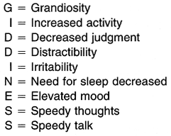
Bipolar disorder in children and adolescents
Silliness and giddiness: but non-manic children can also display these behaviors
Extreme irritability: explosiveness not characterized by ODD or ADHD and sustained for long periods of time
Grandiosity: inflated appraisal of one’s worth, power, knowledge, importance, or identity that must be distinguished from a defensive stance
Decreased need for sleep
Energetic pursuit of nighttime activities
Daytime fatigue is absent: no catching up on sleep
*Mnemonic GIDDINESS for bipolar disorder, manic episode. Wise, M. (1995) in Basco, M.R., Biggs, M.M. and Davies, D. DSM-IV Life Charts and Pocket Guide. Dallas, TX: University of Texas Southwestern Medical Center at Dallas.

Slide 6
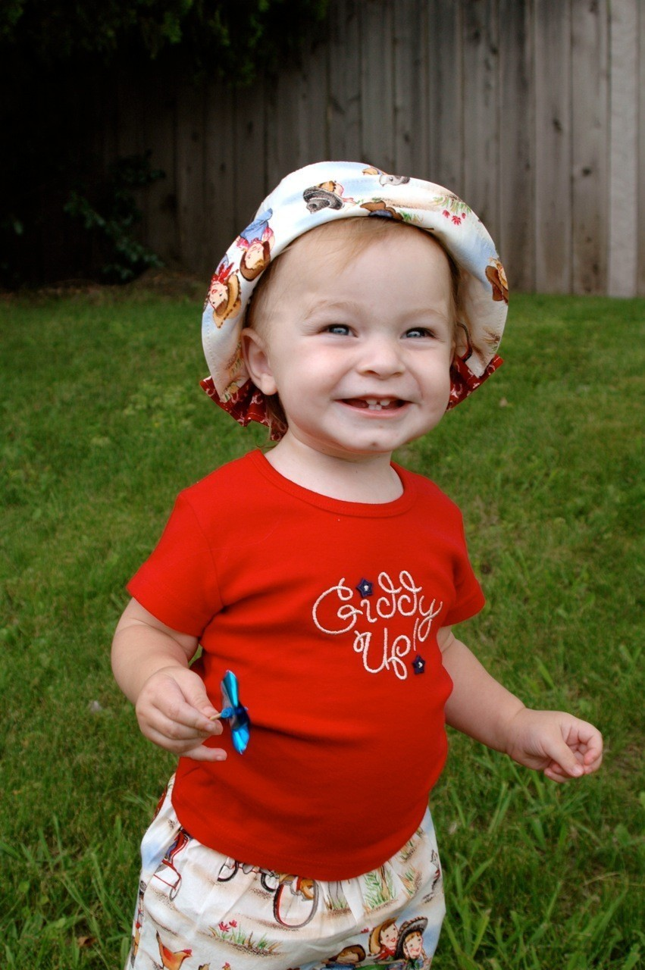
Bipolar disorder in children and adolescents
Increased talkativeness: but most bipolar children are premorbidly talkative
Distractibility: changes or increases not
attributable to ADHD
Increases in goal-directed activity
Excessive involvement in pleasurable activities: but impulse control is often premorbidly problematic
Depression best distinguishes bipolar children from ADHD children with comorbid ODD

Slide 7
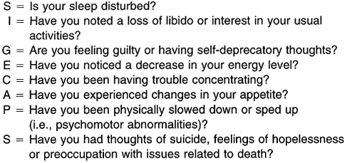
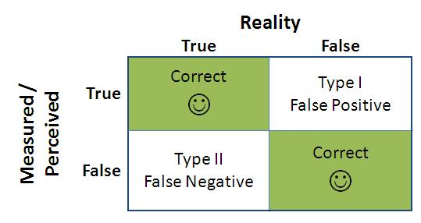
Bipolar disorder in children and adolescents
Identification of bipolar disorder in children:
Reduced specificity: there are false positives (broad definition)
Reduced sensitivity: there are false negatives (narrow definition)
*Mnemonics SIG E CAPS for Major Depressive Disorder. Rauch, S.L., Hyman, S.E. (1995) Approach to the patient with depression. In: Goroll A.H., May LA, Mully AG, Jr. Eds. Primary Care Medicine: Office Evaluation and Management of the Adult Patient. Philadelphia, PA: JB Lippincott, 1033–43.

Slide 8
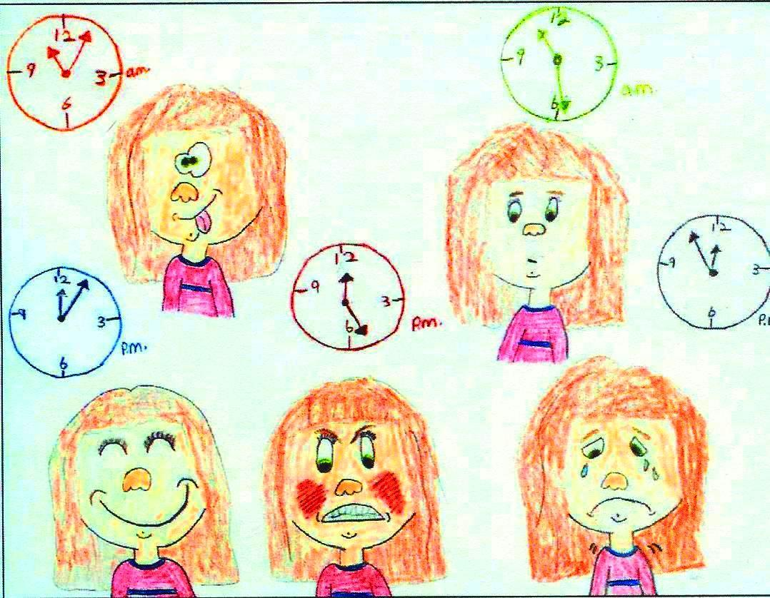
Bipolar disorder in children and adolescents
Children do not have clearly demarcated episodes
Brief periods of marked behavioral dyscontrol
Excessive and situationally inappropriate
Ultradian cycling: cycles appear many times in one day
Episodes are linked to provocation or frustration

Slide 9
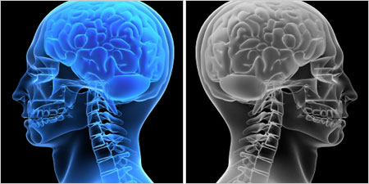
Risk factors and Etiological Formulations
Depression in adolescence (switching to bipolar occurs in 5.5% to 49% over a 15-year follow-up)
Genetic markers: 80% heritability rate
Neurodevelopmental antecedents:
Obstetrical complications
Prenatal exposure to prescription and illicit drugs
Higher rates of premorbid language, motor, and social developmental problems

Slide 10
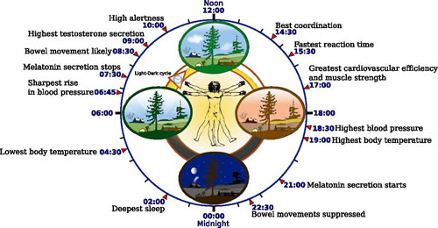
Risk factors and Etiological Formulations
Disturbances of the sleep-wake cycle: circadian irregularity
Endophenotypes
Impaired attentional control
and other executive functions
Depressogenic cognitions:
produced by negative emotional reactivity
Familial stressful events
Child maltreatment
Severe childhood trauma: more pernicious course

Slide 11
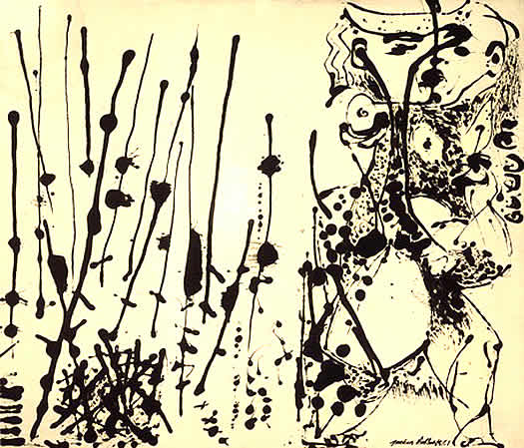
Prevalence
Single-point prevalence: 1-1.5%
Lifetime prevalence: 2.8-6.5%
Adolescence:
.06-.10% (narrow definition)
Adolescence: 5-13% (broad definition)

Slide 12
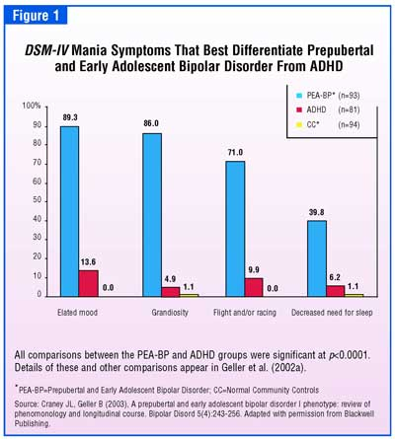
Developmental Progression
Adolescent-onset bipolar disorder: virulent illness that includes serial hospitalizations, substance abuse, suicide attempts, less robust response to meds, worse interepisode functioning
ADHD and onset prior to age 19 had greater functional impairment
Subthreshold manic symptoms not predictive of Bipolar I disorder in adulthood but rather MDD, personality disorders, and anxiety

Slide 13
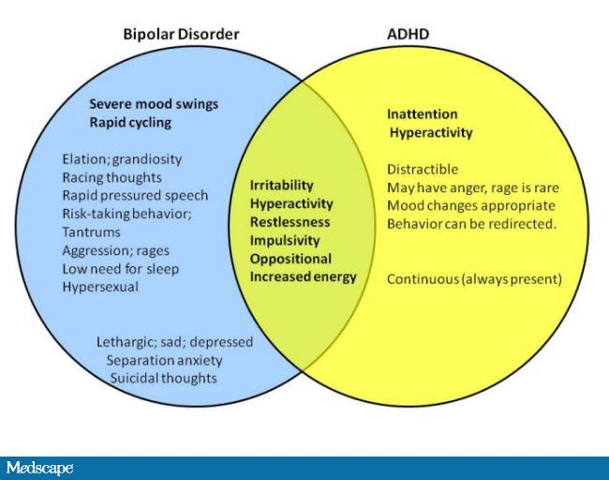
Comorbidity
History of ADHD for bipolar disorder in childhood
77% of bipolar children (with narrow criteria) have at least one comorbid anxiety disorder
12.5% of bipolar children (with strict criteria) have anxiety symptoms (including symptoms persisting through periods of euthymia)

Slide 14
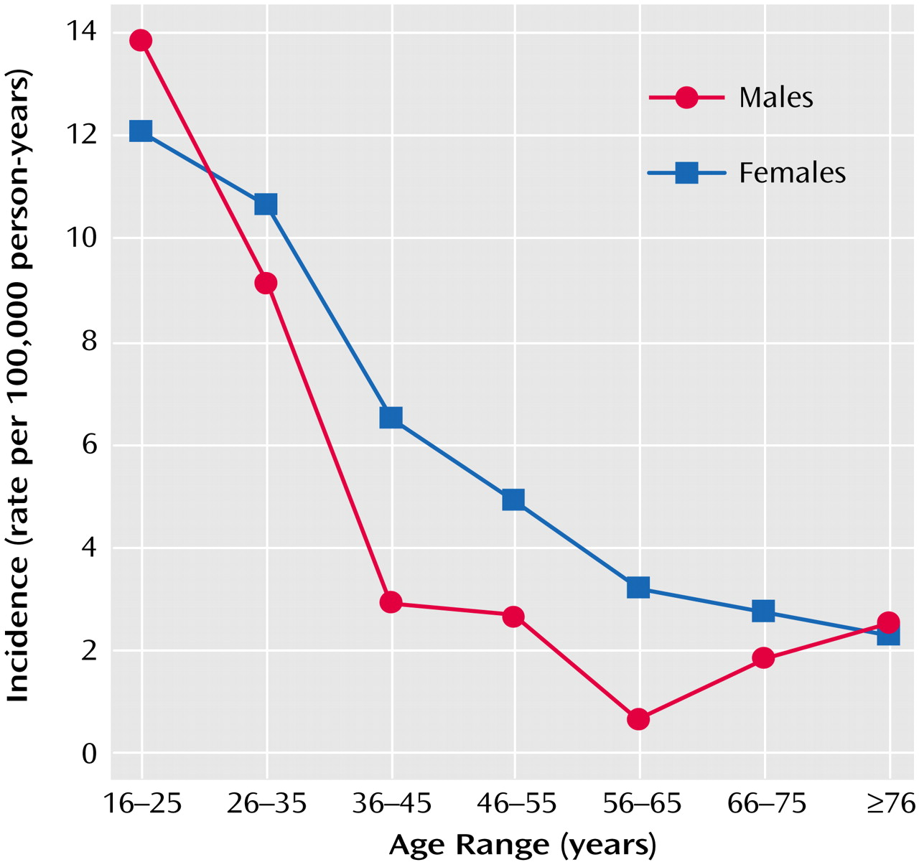
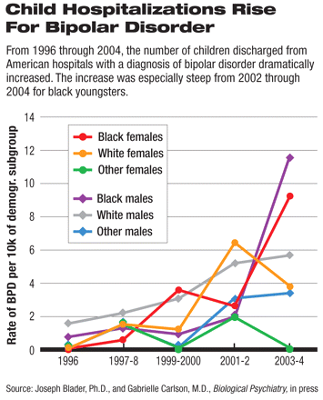
Sex Differences:
Males have earlier onset and more manic episodes
Females have later onset and more mixed and depressive episodes
*Incidence of DSM-IV Bipolar I Disorder, First Manic Episode, by Age and Gender, in Patients Presenting to Treatment Services in Camberwell, England, 1965–1999
**Kennedy N, Boydell J, Kalidindi S, Fearon P, Jones PB, van Os J, Murray RM: Gender differences in incidence and age at onset of mania and bipolar disorder over a 35-year period in Camberwell, England. Am J Psychiatry 2005; 162:257–262.
Cultural Factors:
African-Americans (especially males) are less likely to receive bipolar diagnosis than others
There is little empirical literature on the effect of nonracial cultural factors on bipolar symptom expression

Slide 15
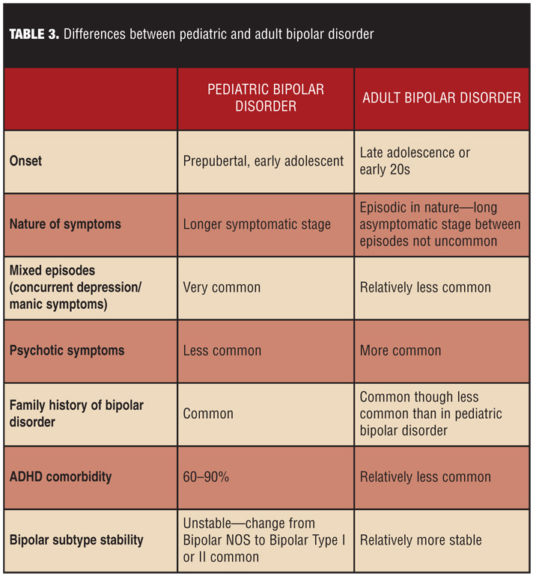
Theoretical Perspective:
Classic versus early-onset bipolar disorder:
Developmental versions of same disease process
Separate types of illness that involve same mechanisms of self-control and mood
Fundamentally different problems that demonstrate phenotypic overlap with bipolar disorder
*Singh, T. (2008). Pediatric bipolar disorder: diagnostic challenges in identifying symptoms and course of illness. Psychiatry (Edgmont), 5(6), 34-42.

Slide 16
Autism Spectrum Disorders: A Developmental Perspective

Slide 17
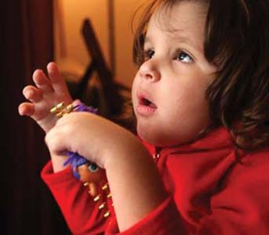
ASD
Diagnostic Features:
Social interaction – no interests or
emotional reciprocity
Communication – delayed language,
repetitive language
Repetitive or restricted behaviors or interests
Appearance before age 3 and can be diagnosed as early as 24 months

Slide 18
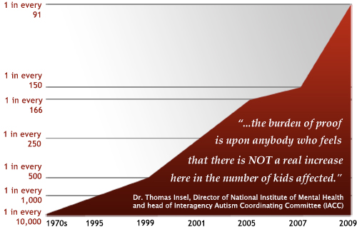
Prevalence
1 out of every 150 persons
Increases in prevalence rate:
Broadening diagnostic criteria
Methodological changes in prevalence research
Increasing awareness and use of autism-spectrum diagnoses
*Published online October 5, 2009, PEDIATRICS (doi:10.1542/peds.2009-1522)

Slide 19
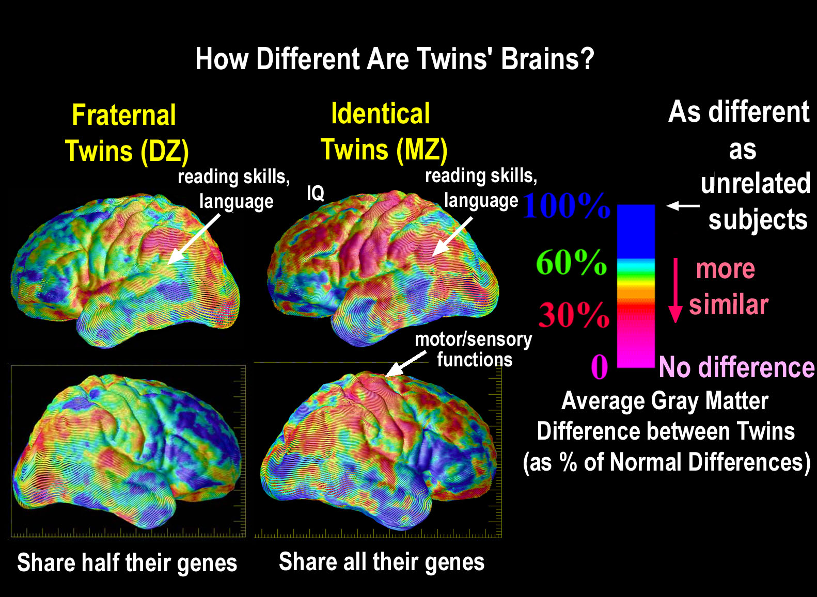
Risk Factors and Etiological Formulations
Genetic Risk Factors:
Concordance rates for MZ twins: 69 - 95%
Concordance rates for DZ twins: 0 - 24%
Concordance rates for siblings: 2.8 - 7%
(but 4.4 - 20.4% can show subthreshold symptoms)
*Thompson et al., (2001). Genetic influences on brain structure. Nature Neuroscience, 4, 1253 – 1258. Published online: 5 November 2001 | doi:10.1038/nn758

Slide 20
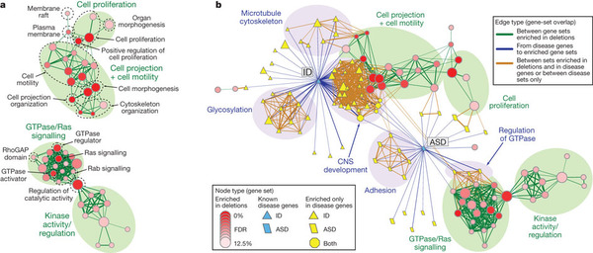
Risk Factors and Etiological Formulations
Multiple genes are involved in transmission
*Pinto et al. (2010). Functional impact of global rare copy number variation in autism spectrum disorders. Nature, 466, 368-372. | doi:10.1038/nature09146; Received 3 December 2009; Accepted 7 May 2010; Published online 9 June 2010

Slide 21
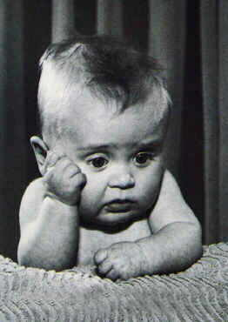
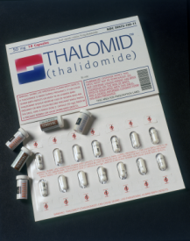
Risk Factors and Etiological Formulations
Environmental Risk Factors:
No obstetrical complications
Exposure to (teratogen) thalidomide during pregnancy (33% rate)
No thimerosal (a preservative containing ethyl mercury) risk in vaccines

Slide 22
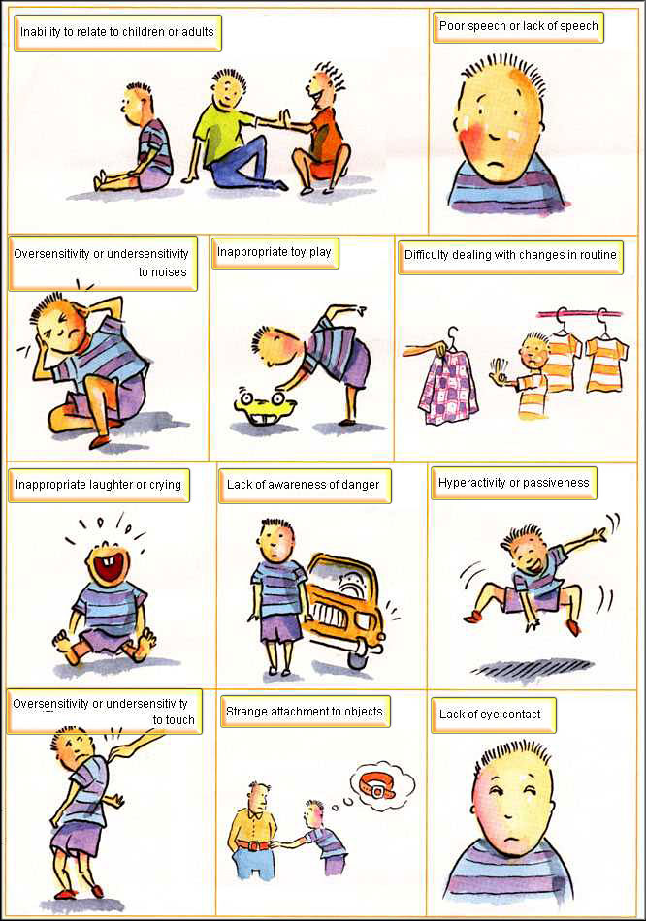
Developmental Progression
Core symptoms often appear by 12 months: less physical contact, vocalizations, looking at faces, smiling at others, less orienting by name, less joint attention, imitation, visual attention
By 14 months: differences in gross and fine-motor skills, receptive and expressive language, and overall intelligence
By age 2: differences in following verbal instructions, babbling or making complex vocalizations, vocal imitation, use of words

Slide 23
Developmental Progression
Autistic regression (20 – 47%): lose skills and develop autism symptoms after 1-2 years of seemingly more typical development
By toddler-preschool, 5 domains of functioning are affected:
Social orienting impairment
Joint attention: coordinate attention between interactive social partners
Attention to emotional cues: less concern over facial distress
Motor imitation: important in development of theory of mind
Face processing: impairments in face recognition as early as age 3

Slide 24
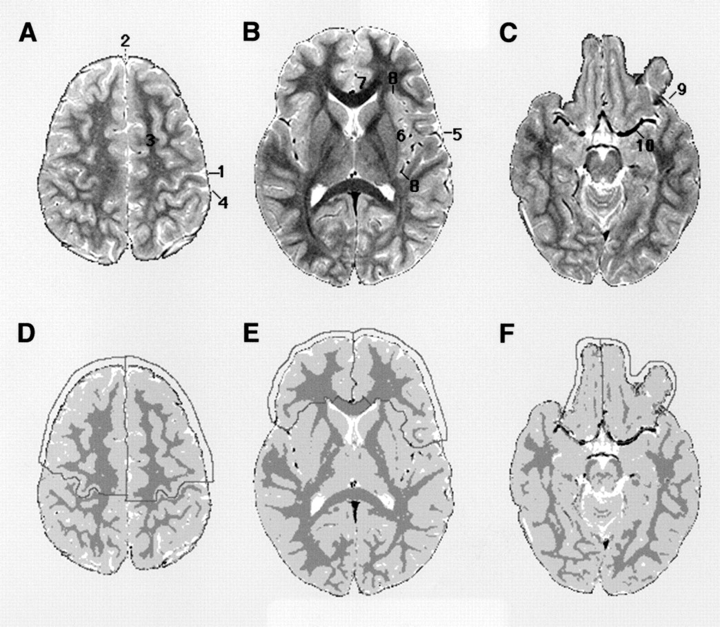
Developmental Progression
Early abnormal brain development
Accelerated growth in head circumference from 4 – 12 months
Excessive enlargement of cerebellar and cerebral white matter and cerebral grey matter
*Anatomical boundaries of frontal lobe. (A–C) T₂-weighted axial images at three representative slice levels, illustrating the location of major neuroanatomical landmarks. (D–F) Segmented images at the same slice levels as in A–C, illustrating the anatomical boundaries used for measurement of frontal lobe volumes. A detailed description of the method is included in the text. 1 = central sulcus; 2 = interhemispheric fissure; 3 = superior frontal gyrus; 4 = postcentral sulcus; 5 = lateral fissure; 6 = insula; 7 = cingulate gyrus; 8 = insular sulcus (circular sulcus); 9 = basal part of lateral fissure; 10 = middle cerebral artery.
**Ruth A. Carper and Eric Courchesne. (2000). Inverse correlation between frontal lobe and cerebellum sizes in children with autism. Brain,123(4), 836-844. doi:10.1093/brain/123.4.836

Slide 25
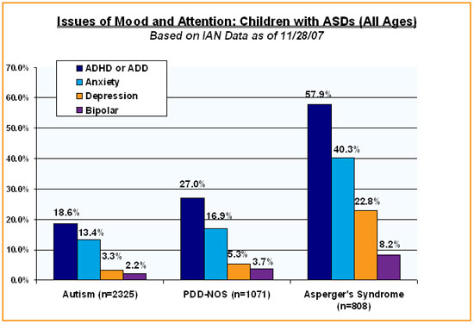
Comorbidity
40 – 70% diagnosed with intellectual disability or mental retardation
Similarities to specific language impairment
Tics (30%), Tourette’s (4.3%), and seizures (5-39%)
OCD (1.5-29%)
Anxiety Disorders (7-84%)
Depression (4-58%)
*The Child with an ASD questionnaire asks parents specifically about their child who has been diagnosed with an Autism Spectrum Disorder. Many of the questions are about a child's diagnosis and medical history. There are 65 potential questions which take approximately 15 minutes to complete.
**Interactive Autism Network Research Preliminary Results: Attention and Mood issues by ASD diagnosis (2007) DOI: http://www.iancommunity.org/cs/ian_research_questions/attention_and_mood_issues

Slide 26
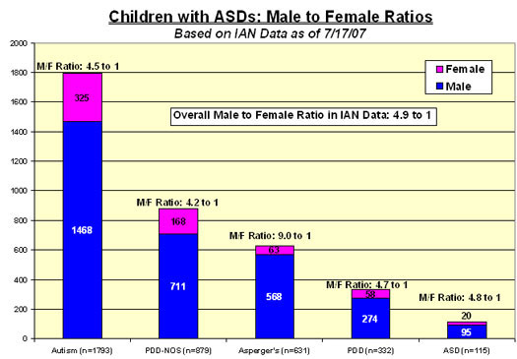
Sex Differences:
Male-female ratio: 3-4:1
Females are more likely to have comorbid mental retardation in the severe range (IQ < 35) and exhibit more severe symptoms
*IAN Research Report #2 - July 2007. Date First Published: August 1, 2007. DOI: http://www.iancommunity.org/cs/ian_research_reports/ian_research_report_july_2007
Cultural Factors:
Non reported – world-wide prevalence

Slide 27
Protective Factors
Early intensive behavioral intervention:
Starting at preschool age
Sustained for 2-4 years
25 hours/week (Rebecca School in Manhattan)
Improvement for 50% of children
Interventions moderated by quality of parent-child interaction:
Improvements in parental sensitivity
Improvements in child behavior

Slide 28
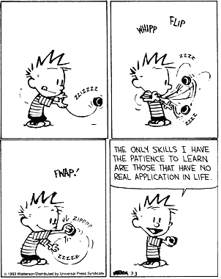
Theoretical Hypothesis: Social Motivation
Social impairments secondary to social motivation or affective tagging of socially relevant stimuli
Social motivations: degree to which child
enjoys spending time with others, prefers
spending time with people, feels comfortable
in social situations
Dopamine system is activated in
response to social rewards, including eye
contact
Oxytocin and vasopressin facilitate
social memory, social bonding, and affiliation
in autism
Unrewarded infants might not attend to faces and voices or perceive social information within a larger social/affective context

Slide 29
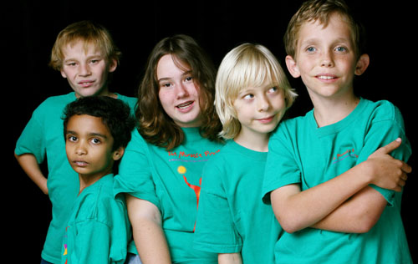
Fin

