Slide 1
Child and Adolescent Psychopathology
Topic of Discussion: Borderline Personality Disorder

Slide 2
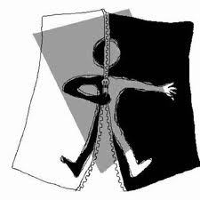
The Development of BPD and Self-Injurious Behavior
History of Borderline Personality Disorder
Borderline between neurosis and psychosis
Kernberg – stable personality organization
Poor anxiety tolerance
Poor sublimatory channels
Poor impulse control
Shifts toward primary-process thinking

Slide 3
The Development of BPD and Self-Injurious Behavior
Borderline pathology in childhood
Children with BP develop a wider range of diagnoses in adulthood, most commonly ASPD
Self-inflicted injury
With suicidal intent
Without suicidal intent
Multiple complex developmental disorder (MCDD)
Dysregulated affect
Intense anxiety
Poor social skills
Interpersonal deficits
Episodic thought disorder
Risk factor for developing BPD? = unknown.

Slide 4
The Development of BPD and Self-Injurious Behavior
BPD can be diagnosed in children, but usually not younger than age 16
Is identity disturbance a normal part of adolescent development?
Prevalence of BPD
0.7% in Norway (over-controlled affect regulation)
0.5-3.9% in the United States (1.4% is best estimate)
11% for ages 9-19; 7.8% for ages 11-21
Prevalence of Self-Inflicted Injury
17% of U.S. adolescents seriously consider suicide
9% of U.S. adolescents attempt suicide
3% of U.S. adolescents make an attempt warranting medical attention

Slide 5
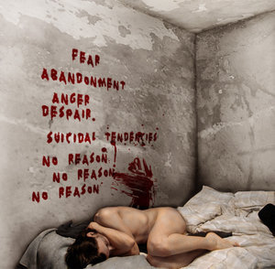
The Development of BPD and Self-Injurious Behavior
Sex Differences
70-80% of BPD individuals are female
70-80% of ASPD individuals are male
Possible reasons for diagnostic discrepancy
Biases in diagnostic criteria, sampling, or assessments
Differences in treatment-seeking behaviors
Differences in expression of psychiatric illness
Is BPD a female manifestation of ASPD?
Both disorders (BD and ASPD) are characterized by three criteria:
Impulsivity
Anger/irritability
Aggression

Slide 6
The Development of BPD and Self-Injurious Behavior
Both disorders – BPD and ASPD – have similar risk factors:
Reduced serotonin
Family dysfunction
Histories of abuse (in some cases)
Between ages 15 and 19, male-to-female ratio of completed suicides is 4.7:1
Possible reasons for differences in suicide rate:
Males use more lethal means
Males have greater exposure to risk factors
Legal difficulties
Financial problems
Shame at failure
Higher rates of comorbidity, including substance abuse

Slide 7
The Development of BPD and Self-Injurious Behavior
Risk factors and etiologic formulation of BPD
Psychological risk factors
Comorbid Axis I disorders – mood disorders, anxiety disorders, substance use disorder, eating disorders
Comorbid Axis II disorders – Cluster C (anxious; 62.4%); Cluster B (dramatic; 27.7%); Cluster A (odd; 23.8%)

Slide 8
The Development of BPD and Self-Injurious Behavior
Developmental sequence of precursors
Behavioral dyscontrol
Emotion dysregulation
Family psychopathology
Impulse control disorders
Mood disorders
Substance use disorders
CD/ASPD

Slide 9
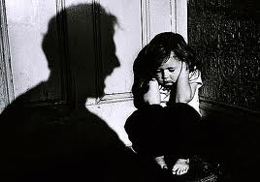
The Development of BPD and Self-Injurious Behavior
Family stressors – divorce, parent-child conflict, physical abuse, frequent changes of residence, history of SII
Preoccupied and unresolved attachment
Punish or trivialize emotional expressions rather than validating them
Abuse histories are neither necessary nor sufficient for BPD

Slide 10
The Development of BPD and Self-Injurious Behavior
Sexual orientation
Increased risk for suicide attempts
Increased risk mediated by stigma, shame, victimization, social rejection
Genetic, neurochemical, and biological risk
Relatives of self-injury individuals are at three times the risk
Concordance rate for BPD is 38% for monozygotic twins and only 11% for dizygotic twins.

Slide 11
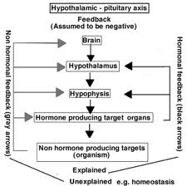
The Development of BPD and Self-Injurious Behavior
Genetic, neurochemical, and biological risk (cont’d)
Impulsive aggression and affective instability are heritable traits
Impulsive aggression linked to genetic polymorphism and functional impairments with serotonin (5-HT) and dopamine systems
Affectivity instability linked with increased norepinephrine (NE) and outward aggression as well as decreased NE and social withdrawal
Chronic stress produces elevated hypothalamic-pituitary-adrenal (HPA) axis response

Slide 12
The Development of BPD and Self-Injurious Behavior
Genetic, neurochemical, and biological risk (cont’d)
Deficits in prefrontal cortex (PFC) contribute to suicidal and other impulsive behaviors through failure to inhibit aggressive impulses
BPD is linked to reduced respiratory sinus arrhythmia (RSA)
Temperamental qualities of BPD
Low agentic extraversion (positive emotion) → affect dysregulation
High anxiety (negative emotion) → affect dysregulation
Diminished constraint → impulsivity
These qualities can determine course and targets for intervention

Slide 13
Biosocial Developmental Model of BPD
Biological vulnerabilities
BPD similar to other impulse control disorders such as ADHD and CD
Self-inflicted injuries could be developmental precursor to BPD
Polymorphisms in genes affecting 5-HT and dopamine expression

Slide 14
Biosocial Developmental Model of BPD
Interaction with social environment
Biological traits (behavioral reactivity, impulsivity, oppositionality, emotional sensitivity) interact with caregiver’s unsuccessful attempts to manage and control a difficult child
Emotional invalidation of caregiver
Coercive, emotionally labile caregiver – child interaction patterns
Self-inflicted injury is discovered as a means of coping with extreme emotional distress

Slide 15
Biosocial Developmental Model of BPD
Interaction with social environment (cont’d)
Self-inflicted injury in turn increases caregiver stress and negatively influences family functioning in a vicious cycle
Personal and environmental resilience can mitigate against the development of BPD

