Slide 1
Internalized Colorism in the Classroom
Heterogeneous and Homogenous Grouping as Moderators of Self-Skin Tone Identification
Lauren Taveras

Slide 2
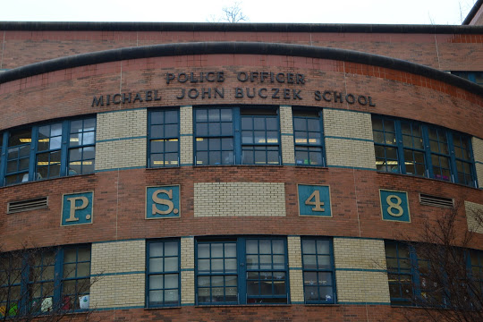
1st Grade, Washington Heights, NYC

Slide 3
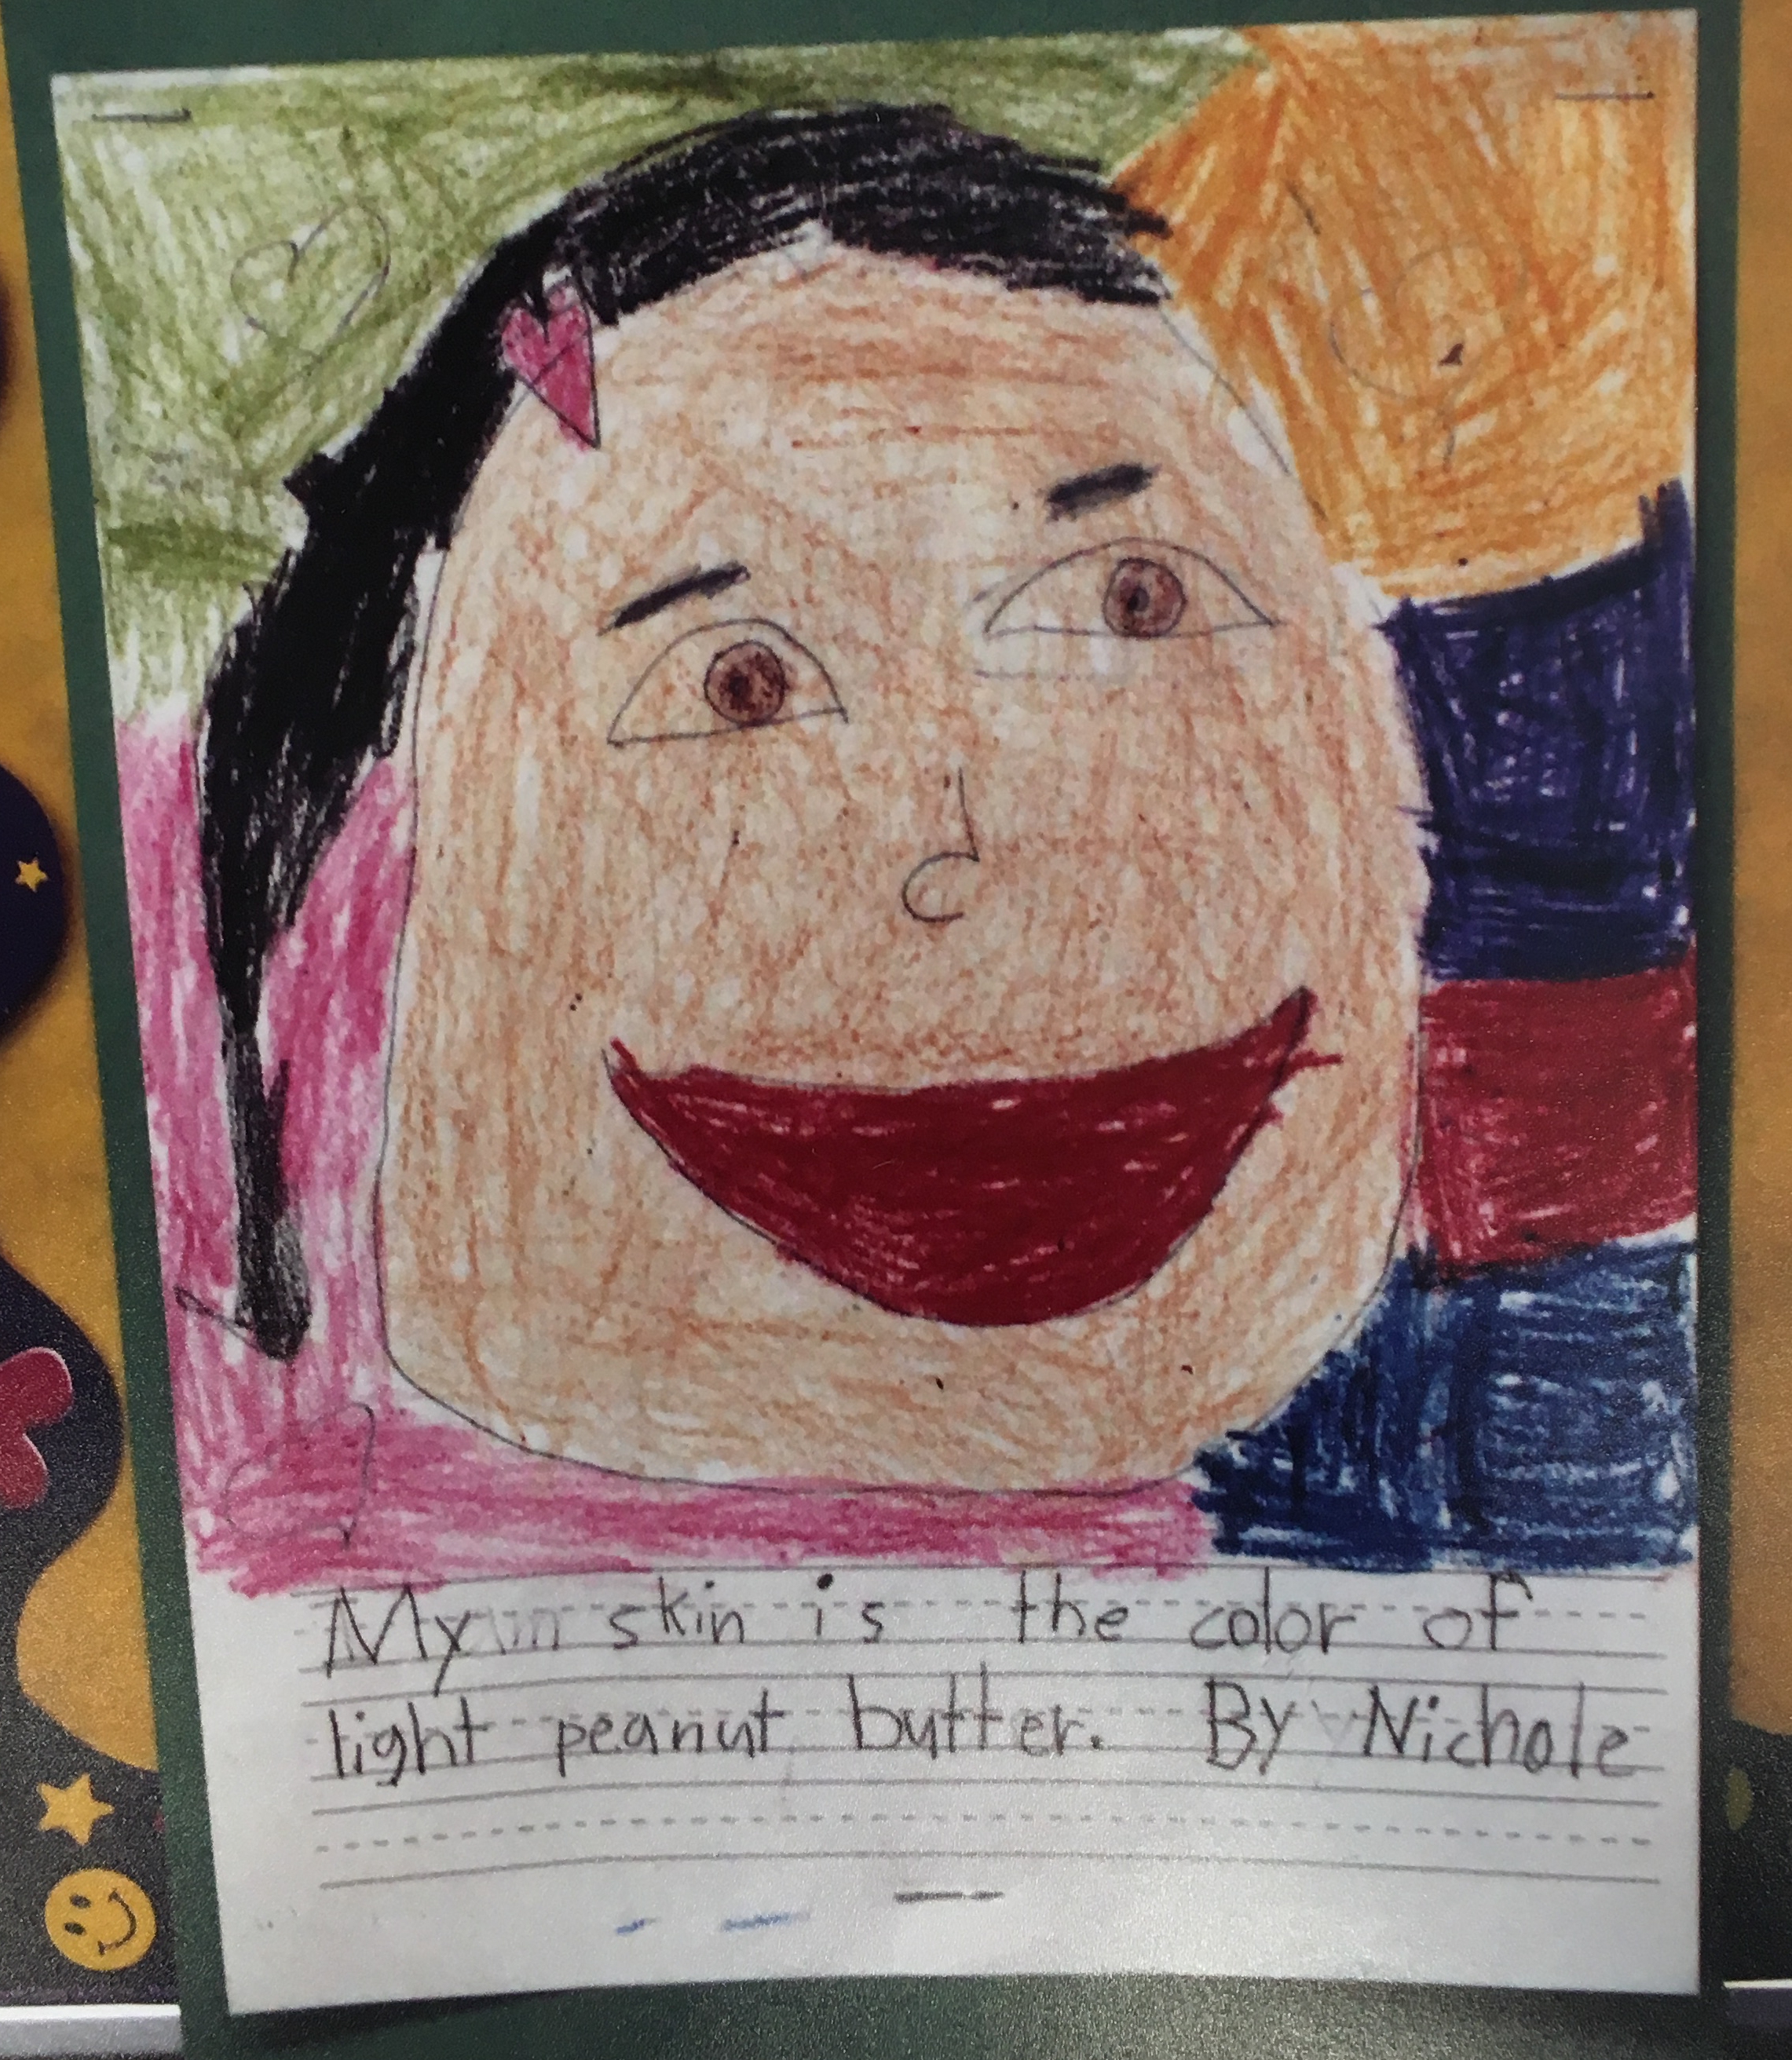
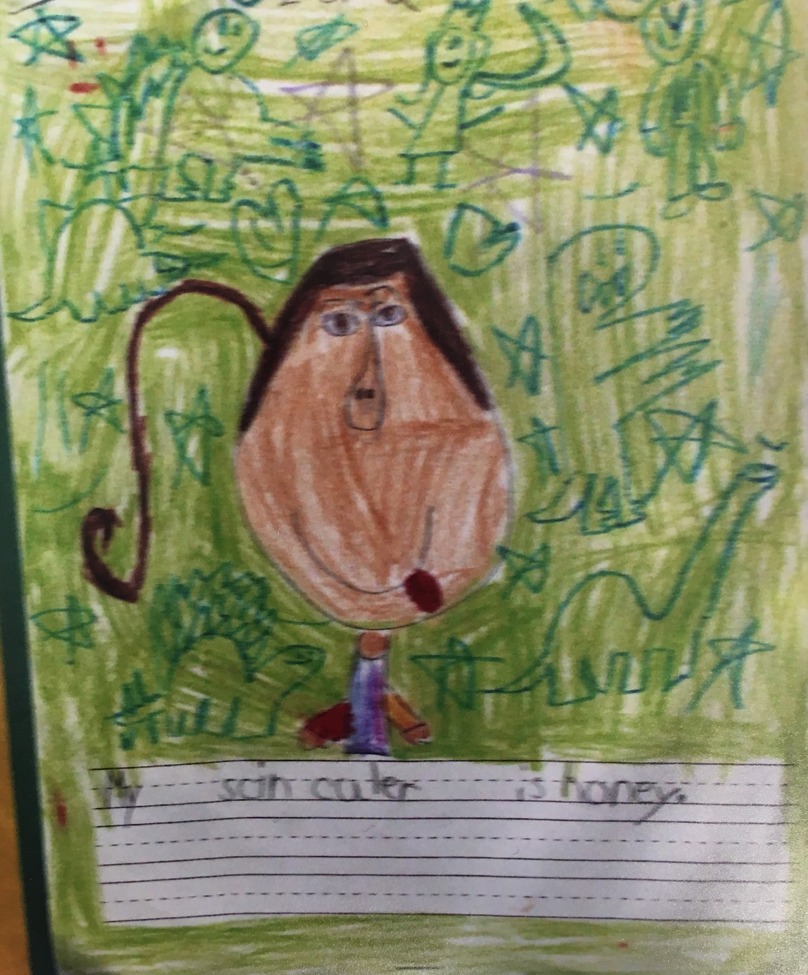
My skin is the color of…

Slide 4
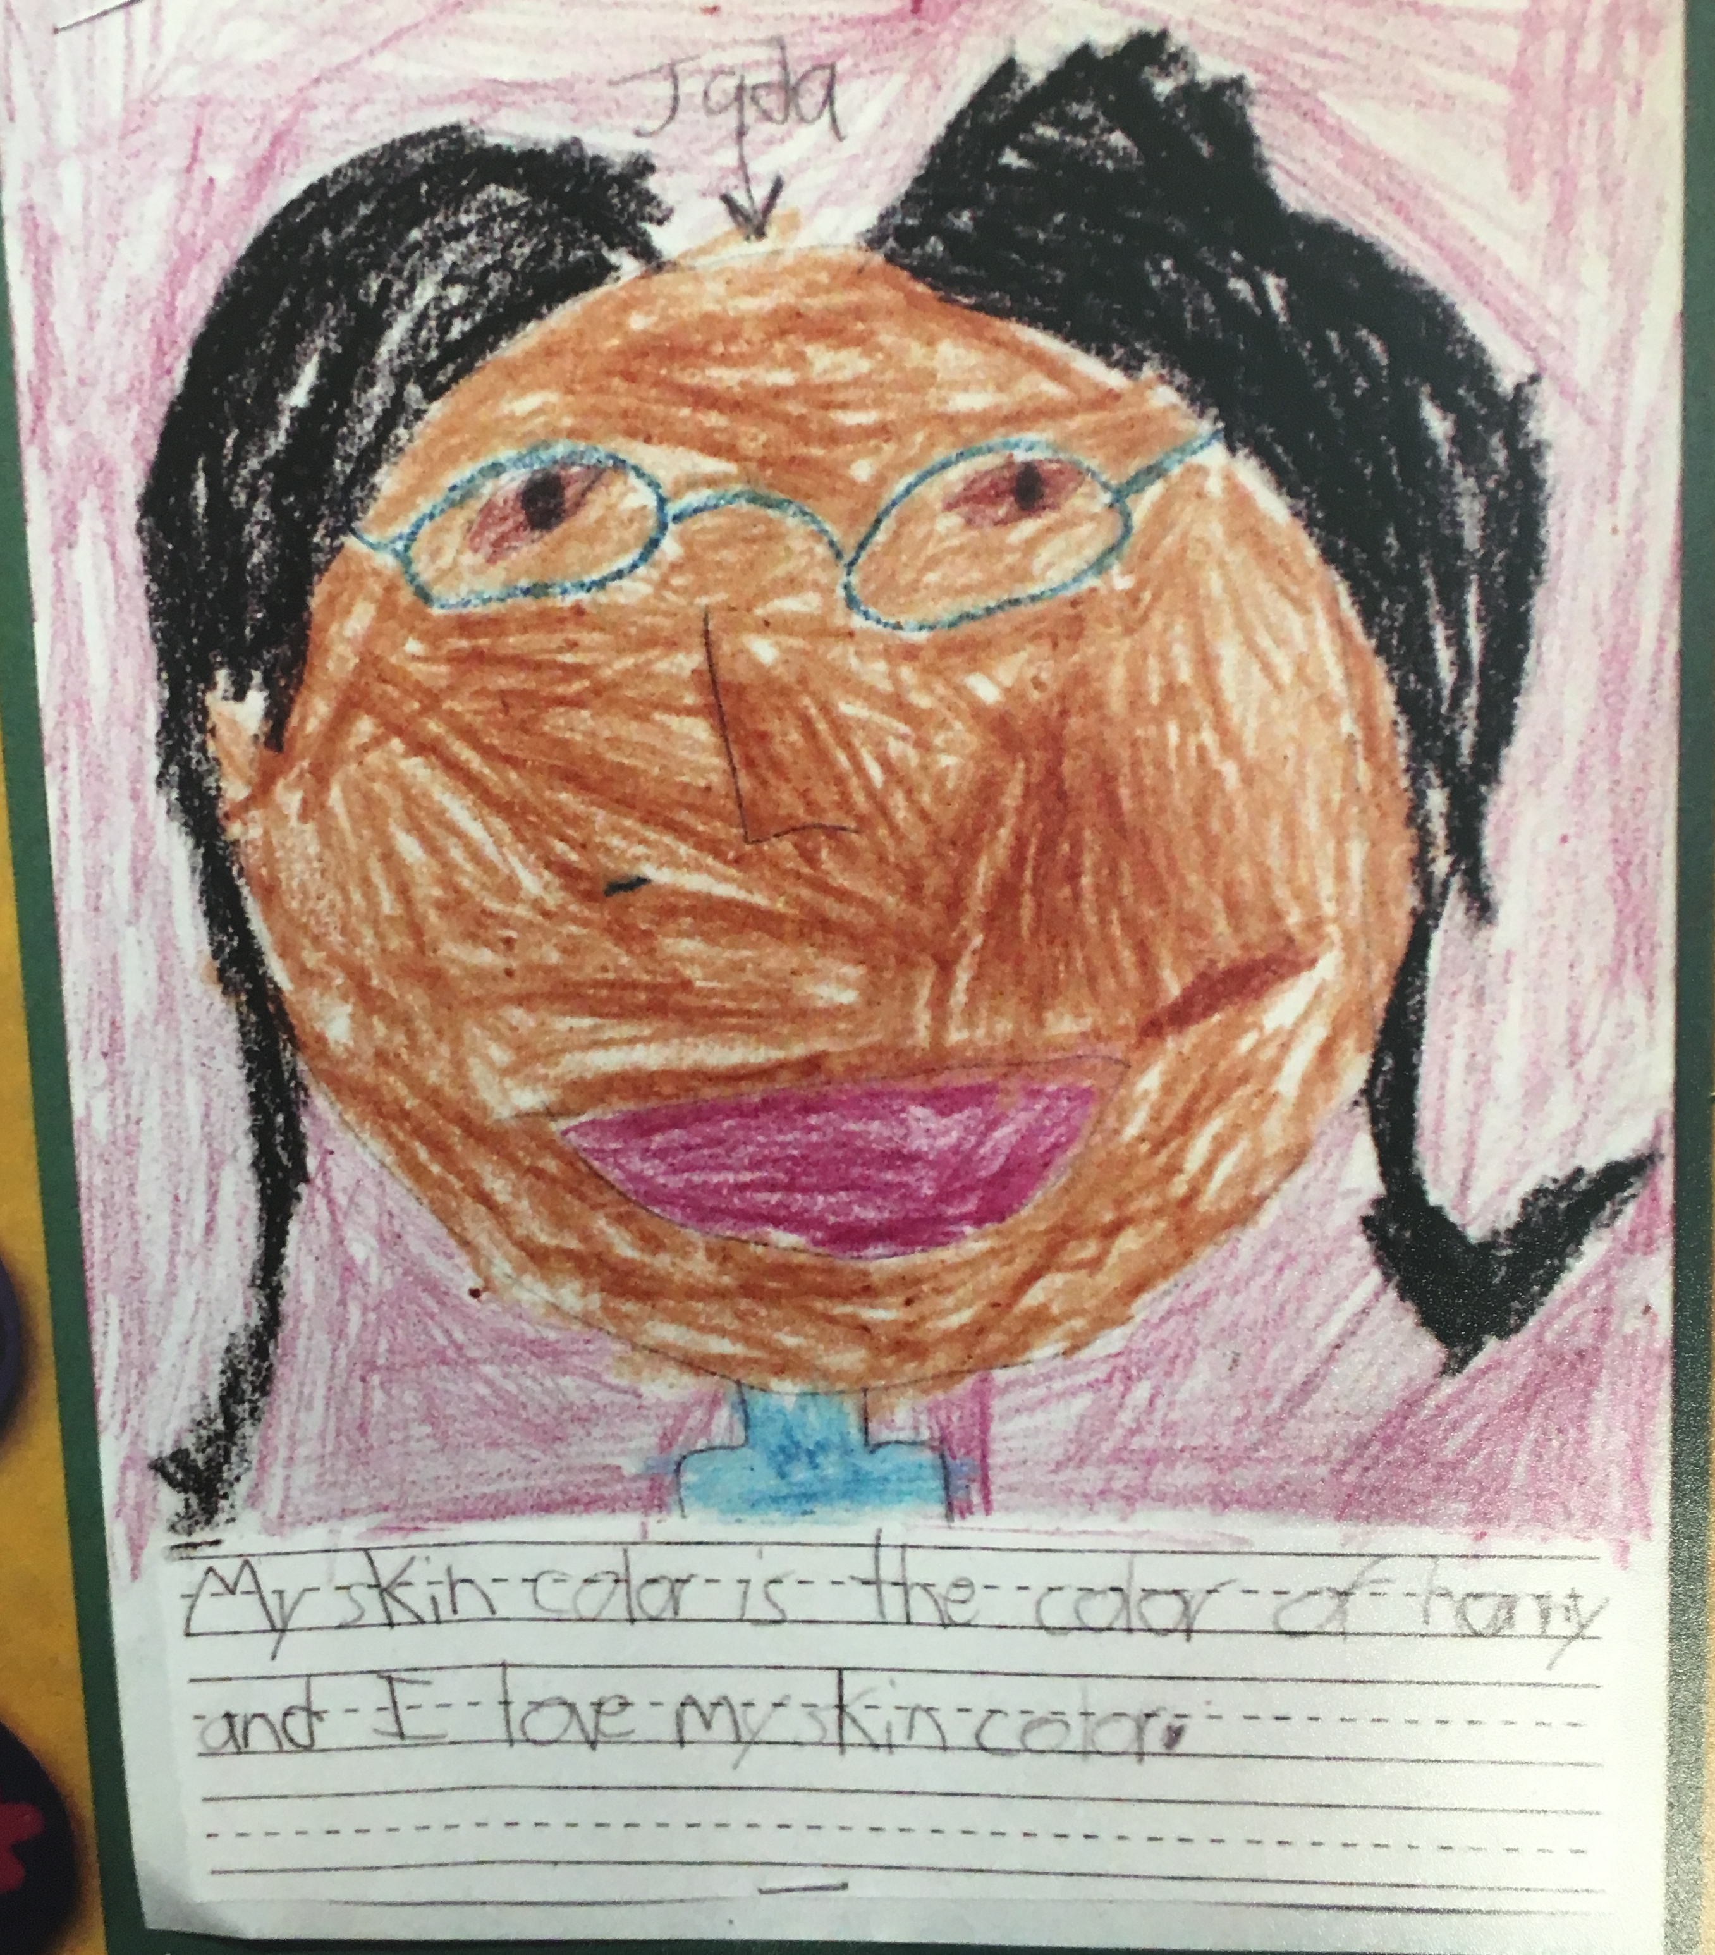
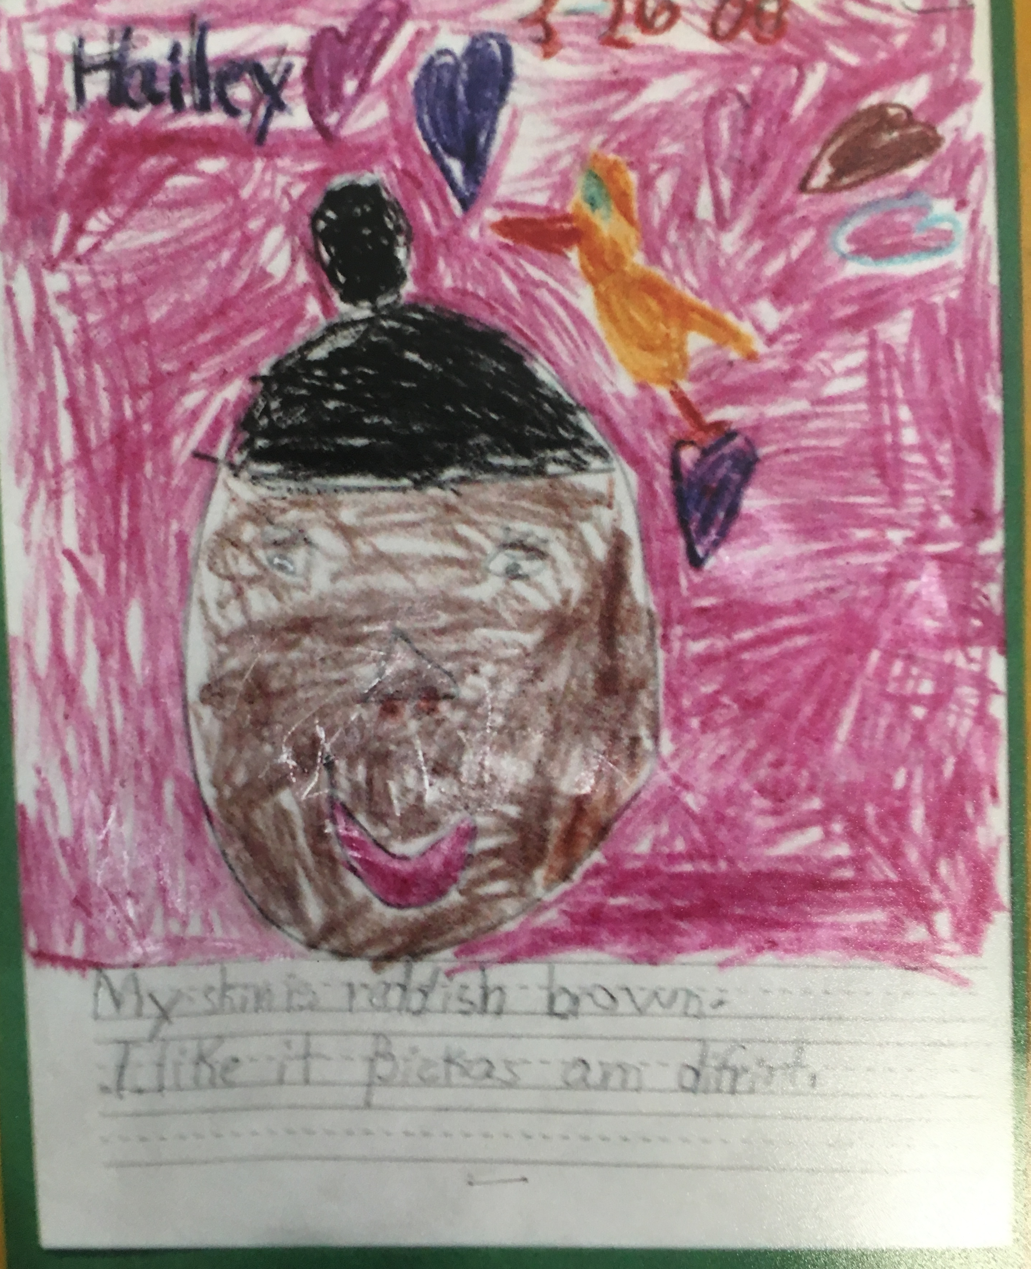
My skin is the color of…

Slide 5
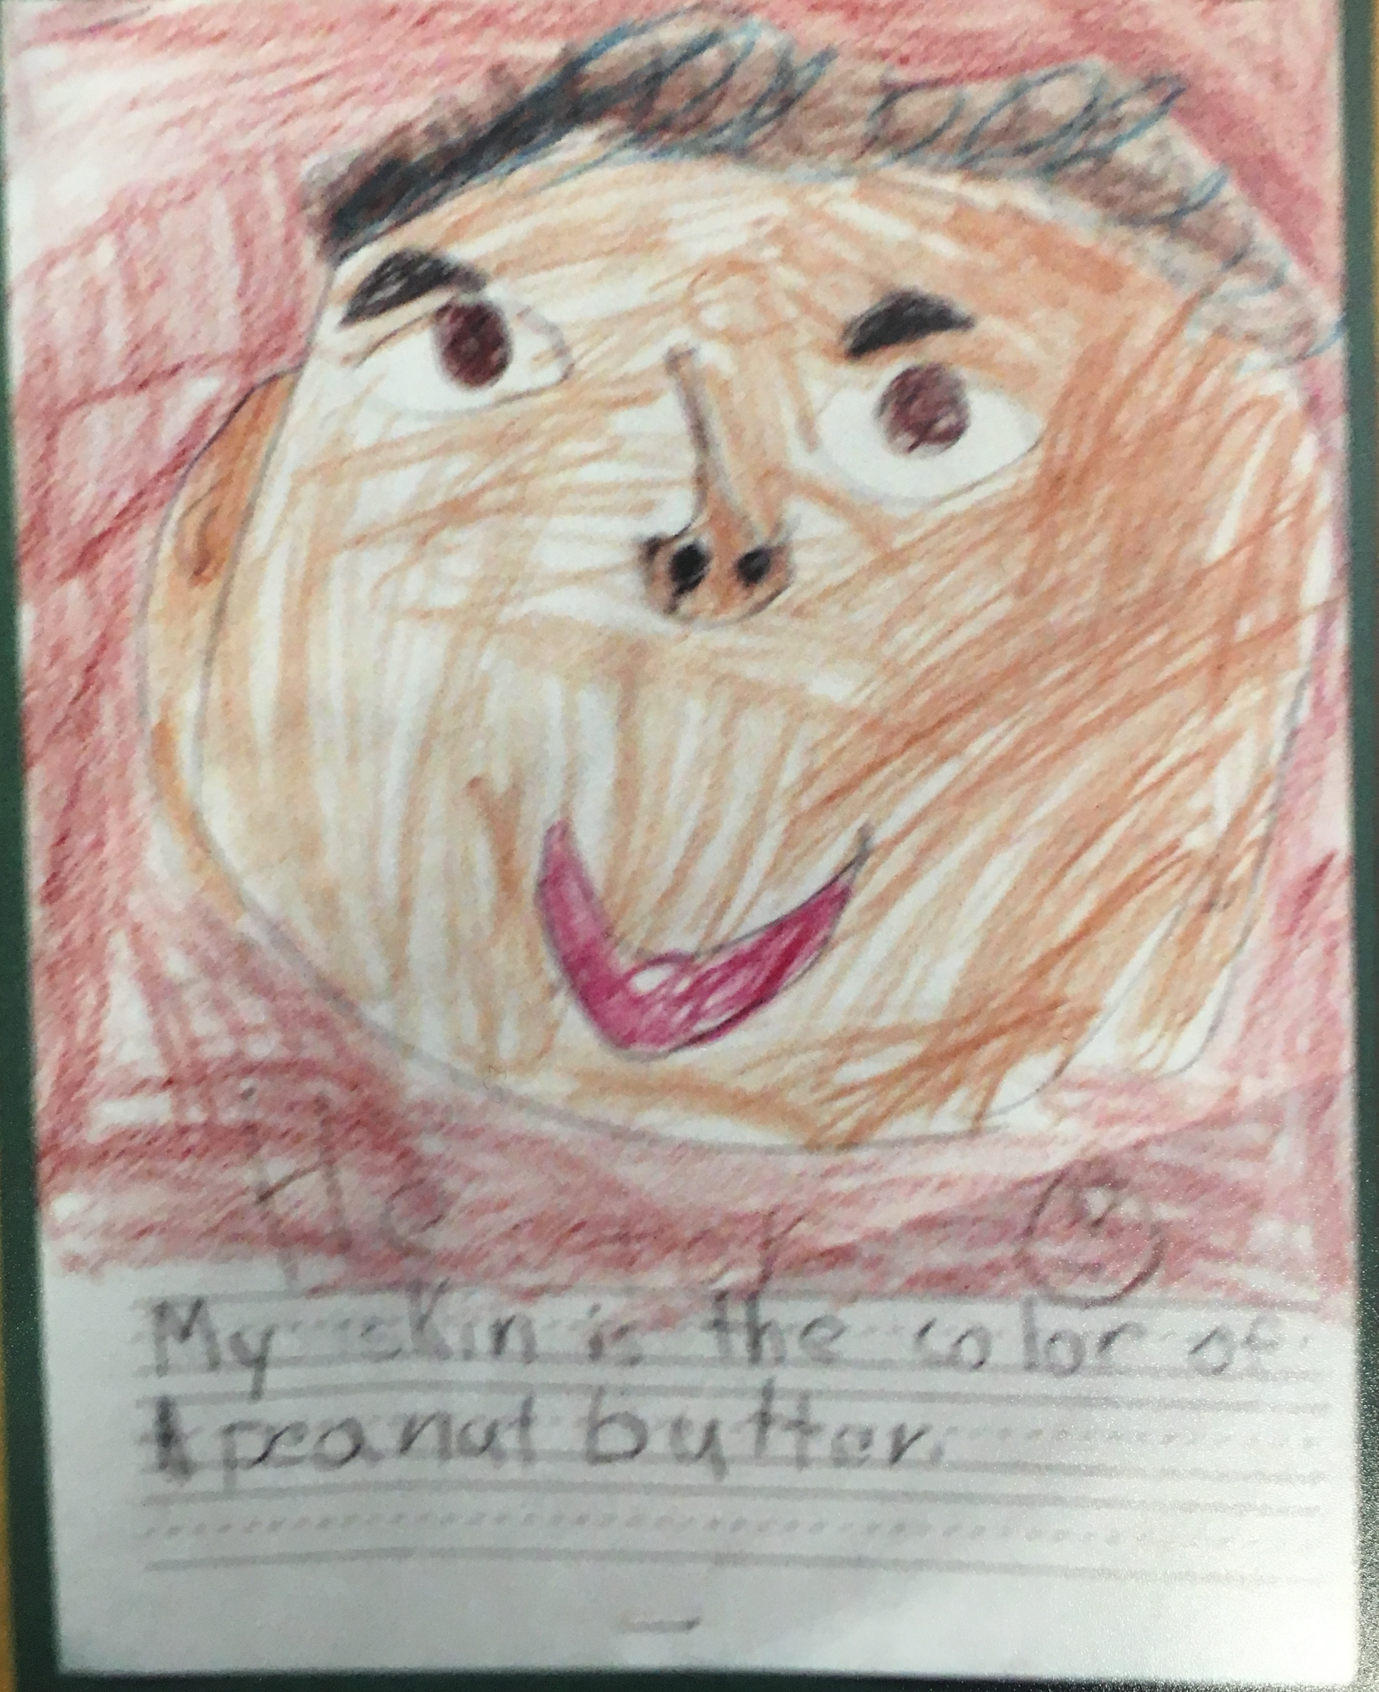
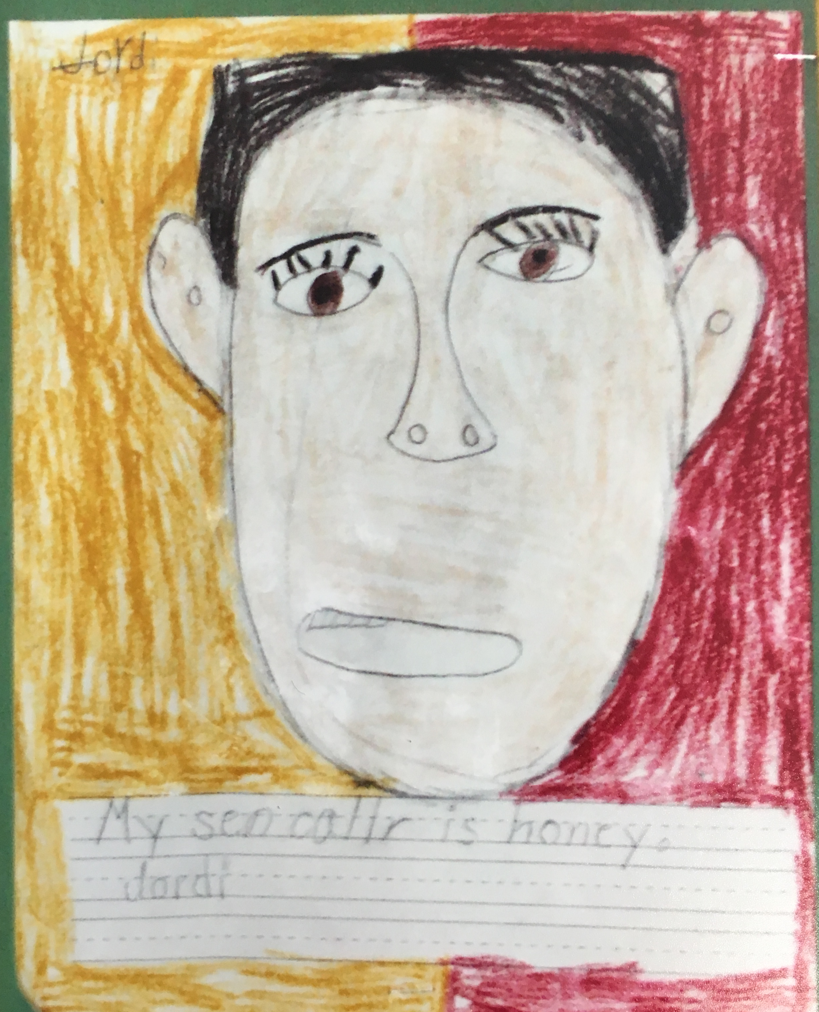
My skin is the color of…

Slide 6
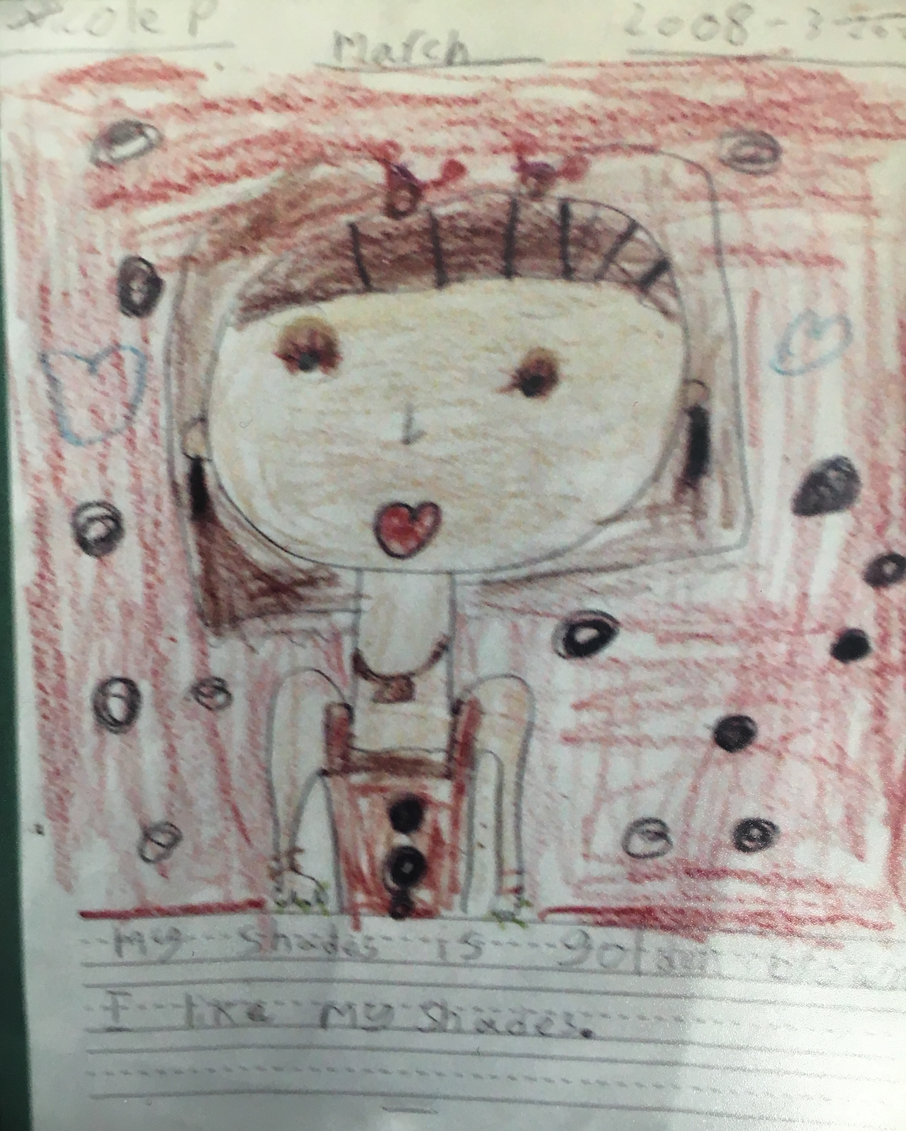
Literature Review
Colorism: inequality based upon skin tone
Internalized Racism: the internalization of racially prejudiced attitudes towards one’s own racial group, and even oneself

Slide 7
Colorism in the classroom
Colorism serves as a substystem of structural racism within school settings (Hunger, 2016)
Light-skinned people of color complete more years of school than darker-skinned people of color (Allen, Telles, & Hunter, 2000; Keith & Herring, 1991; Murguia & Telles, 1996; Telles & Ortiz, 2008).
Halo effect (Nisbett & Wilson, 1977) → lighter-skinned individuals considered more attractive, intelligent, and kind (Wade, 2008)
Beauty queue (Hunter, 2002): Girls with lightest skin tones rates as more physically attractive and socially popular

Slide 8
Internalized colorism
To what extent are children internalizing colorism?
Clark & Clark (1947): Black dolls ascribed more negative characteristics, and White dolls ascribed more positive characteristics by Black and White preschool children, alike

Slide 9
Hypotheses
Racial-ethnic group hetero- and homogeneity moderates the relationship between African American and Latino/a first graders’ racial identity and the accuracy of their self-skin tone identification.
Racial-Ethnic Group | Homogeneous Group | Hetergeneous Group
African American | Antagonistic Moderational Effect | Enhanced Moderational Effect
Latino/a | Antagonistic Moderational Effect | Enhanced Moderational Effect
White | No Effect | No Effect

Slide 10
Hypotheses Broken down
ENHANCED Moderator Effect: African American and Latino/a children in homogeneous racial-ethnic conditions (moderator), increasing the impact of racial-ethnic identity (independent variable) on more accurate self-skin tone identification (dependent variable).
ANTAGONISTIC Moderator Effect: African American and Latino/a children in heterogeneous racial-ethnic conditions (moderator) reversing the impact of racial-ethnic identity (independent variable) on accurate self-skin tone identification (dependent variable).
NO INTERACTION: White children (independent variable), homogeneous versus heterogeneous racial-ethnic conditions (moderator) are not expected to significantly impact accurate self-skin tone identification (dependent variable).

Slide 11
Methods
Participants
146 first graders; 42 African American, 42 Latino/a; 42 White
Design
21 African American, 21 Latino/a, 21 White to 3 Homogeneous Groups
21 African American, 21 Latino/a, 21 White to Heterogeneous Groups
Random Assignment to hetero/homogeneous groups
Procedures
Met with principal, superintendent, LIU Post IRB
Informed Consent
Student Group Assignment
The Skin You Live In—Read-aloud → Drawing activity
Researchers rated student skin tone & crayons selection based on Color Wheel
Measures
Color Wheel (Coard, Breland, & Raskin, 2001)
Data Analysis
Two-by-three factorial independent ANOVA
Notes:
.92 correlation between raters (k = .92) (skin color)
.88 correlation between raters (k = .88) (skin tone selection via people colored crayon)

Slide 12
Significant results
African American and Latino/a children were significantly more accurate in self-skin tone identification when in homogeneous racial-ethnic groups, with an average discrepancy between actual and self-selected skin tones of 1.2 shades (p = .03).
Enhanced Interaction/Moderational Effect
African American and Latino/a children were significantly less accurate in depicting their skin tones, with an average discrepancy of 4.3 shades lighter than their actual skin tones (p = .02).
Antagonistic Interaction/Moderational Effect
No significant differences in skin-tone identification for White children in homogeneous versus heterogeneous conditions (p = .8); the average discrepancy between selected skin tones for White children was .5 shades.

Slide 13
Nonsignificant results
African American and Latino/a children were only slightly more accurate in self-skin tone identification when in homogeneous racial-ethnic groups, but the discrepancy between conditions was nonsignificant (p = .8), revealing the absence of an interaction effect between racial-ethnic identity and self-skin tone identification in the presence of homogeneous versus heterogeneous racial-ethnic groups.
No significant discrepancies between White children’s and African American or Latino/a children’s accuracy in self-skin tone identification in either condition (p = .9), again revealing that racial-ethnic group condition had no moderational effect on the variables in question.

Slide 14
Implications for future research
Results without priming (i.e., The Skin You Live In)?
Latino/a Children only? Caribbean/Dominican children?
Pre/Post participation in diversity-focused curriculum?

