Slide 1
Child & Adolescent Psychopathology
PS - 861

Slide 2
Multiple-Levels-of Analysis Perspective
What we have learned from this perspective:
Prediction of psychopathology and resilience depends on consideration of multiple risk and protective factors
a. maltreated children exposed to neighborhood violence
b. male gender as a protective factor for Eating Disorders
c. male gender as a risk factor for Conduct Disorder d. high-risk, low SES, high authoritarian parenting→+/- outcomes
Multifinality – same risk factors produce different outcomes
Equifinality – different risk factors produce same outcomes
Specificity of prediction enhanced with knowledge of differential mechanisms in disparate subgroups.

Slide 3
Multiple-Levels-of Analysis Perspective
What we have learned from this perspective (cont’d):
Cause of development is the relationship between two or more components, not the components themselves (interaction effects)
Maltreatment causes secretion of hormones, which in turn can activate certain genes.
Change in developmental course
New experiences
Reciprocal interactions between levels of the developing person
Individual’s activate self-organizing strivings for adaptation.

Slide 4
Multiple-Levels-of Analysis Perspective
Multiple Levels of Analysis
Definition – “different scales into which behavior or the brain can be represented.” (p. 33)
Levels vary in organization from molecular to sociocultural.
Gene-Environment (G-E) Interaction
Psychopathology as on a continuum or a discrete entity?
“G-E effects play an important role in comprehending the development of mental health and disorder.” (p. 35)

Slide 5
Multiple-Levels-of Analysis Perspective
Emerging empirical evidence of G-E and psychopathology
Additive model: maltreatment + functional polymorphism→ antisocial behavior
Moderational model: maltreatment * functional polymorphism→ antisocial behavior
Stressful life events + functional polymorphism→ depression
Stressful life events * functional polymorphism→ depression
Maltreatment * functional polymorphism→ depression
Maltreatment * functional polymorphism * low social support → depression
Study of endophenotypes – constructs beneath the observable surface that underlie mental disorders (e.g., hormones like cortisol)

Slide 6
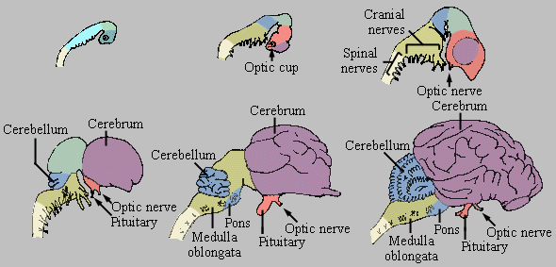
Multiple-Levels-of Analysis Perspective
Early adverse experiences affect brain development
Average expectable environment (Heinz Hartmann)
Species-specific ranges of environmental conditions that facilitate normative development
Different average expectable environments at different ages
Secure base and exploration (Bowlby)
Input from social environment→ cytoacrchitecture of cerebral cortex
Early stresses condition young neural networks to produce cascading effects in later development

Slide 7
Multiple-Levels-of Analysis Perspective
Early adverse experiences affect brain development (cont’d)
Maltreated children have smaller brains, neuronal loss, slow startle response
Critical period is of importance
Duration of maltreatment is of importance
Gender differences in maltreated children
Girls – smaller corpus callosum associated with sexual abuse
Boys – slower and less intense startle response
Maltreated children have suppressed cortisol levels; habituation to high stress (affects cognition, memory, and emotion)
Cortisol helps people to manage stressful experiences competently, physiologically, and behaviorally
Stress hormones affect the expression of genes

Slide 8
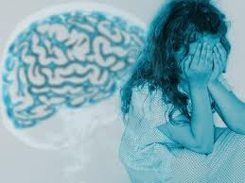
Multiple-Levels-of Analysis Perspective
Early adverse experiences affect brain development (cont’d)
Maltreated children have hostile attribution bias (Ken Dodge)
Maltreatment affects interpretation of ambiguous stimuli (e.g., faces, vignettes)
Transference – “responding in this fashion may provide maladaptive solutions when employed outside of the maltreating situation and may contribute to their social-cognitive difficulties and increased risk for…psychopathology.” (p. 47)

Slide 9
Multiple-Levels-of Analysis Perspective
Resilience from a multiple-levels-of analysis perspective
Definition: “an individual’s attainment of positive adaptation and competent functioning despite the experience of chronic stress or detrimental circumstances.” (p. 47)
Multifinality and equifinality also operate in resilience
Resilient children can also transform their social environments
Preventive Interventions
Bidirectional transactions between different levels of organismic organization
Environment (including intervention) influences biology
Biology (including medication) influences environment
Influence of preventive interventions on repair of biological sequelae is little understood.

Slide 10
Genetic & Environmental Influences on Behavior
Historically, genetics and environment were treated as separate
Gene-Environment (G-E) interactions are considered prevalent
Impulsive boys * high-violence neighborhoods→ antisocial behavior
Impulsiveness might evoke reactions from others that exacerbates inherited vulnerabilities
Schizophrenia genes * protective familial environments→ no disorder
Terminological and conceptual issues
Genotype – genetic composition of the individual
Phenotype – observable characteristics (behavioral and physical) that result from interaction between genes and environment
Endophenotype – measurable components unseen by the unaided eye along the pathway between disease and distal genotype
Neurological difference
Brain differences
Hormonal differences

Slide 11
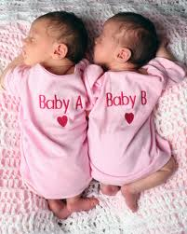
Genetic & Environmental Influences on Behavior
Psychiatric Genetics
Parse variability in behavioral traits
Additive genetic effects (A)
Genetic effects
Heritable effects – genes turned “on” during pregnancy
Shared environmental effects (C)
Non-shared environmental effects (E)
A² + C² + E² = 1.0 (variance accounted for)
Heritability characteristics can be inflated
Molecular Genetics
Linkage studies – specify specific chromosomes where affected genes are located
Association studies – candidate genes compared between people with and without the disorder
Problems with symptom assessment and participant selection
Equifinality – risk factors involved

Slide 12
Genetic & Environmental Influences on Behavior
Gene-Environment (G-E) Interdependence
Definition: “heritable and environmental influences either correlate or interact with one another to explain more variance in behavior than their combined main effects.” (p. 71)
Maltreatment * functional polymorphism→ depression
Main effect of maltreatment
No main effect of maltreatment
Influence of functional polymorphism is hidden
Passive gene-environment correlation (rGE) – genetic factors common to parent and child influence parenting behaviors
Active rGE – child’s heritable vulnerabilities influence his/her slection of environments
Evocative rGE – genetically influenced behaviors elicit reactions from others that interact with and exacerbate existing vulnerabilities (e.g., impulsivity)
Affect neural systems
Affect environments (self-fulfilling prophecy)

Slide 13
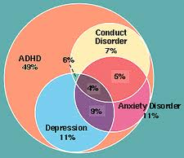
Genetics & Environmental Influences on Behavior
Genetics in Comorbidity
Homotypic comorbidity – multiple externalizing or internalizing disorders within the individual
Heterotypic comorbidity – co-occurrence of one externalizing disorder and one internalizing disorder
Psychoanalytic view of heterotypic comorbidity (e.g., depressed APD
Genetics of Continuity
Homotypic continuity – unfolding of a single class of behavioral/emotional disturbance over time (e.g., aggression, anxiety)
Heterotypic continuity – sequential development of different internalizing or externalizing behaviors or disorders across the lifespan e.g., ADHD→ODD→CD→APD)

